Slide 1
IET 333: Engineering Economics for Technologists
Jung-woo Sohn (jwsohn@ist.psu.edu)
College of Information Sciences and Technology
Penn State University

Slide 2
About me:
Jung-woo Sohn
Contact information:
E-mail: jzs177@psu.edu
Office: TBD in LRC
Office hour: TBD on Tuesday or Thursday
Teaching career:
Instructor:
Introduction to programming in C++ (CMPSC121, Spring 2014)
Teaching assistant: College of Info Sci & Tech at UP
Many courses largely programming, business, economics, or engineering disciplines

Slide 3
My background
Pretty much interdisciplinary:
B.S., M.S. in Aerospace Engineering
M.S. in Information Science
M.S. in Economics
Ph.D. in Information Sciences and Technology
Computer science (artificial intelligence)
Experimental economics
Others
Linux geek
Likes computer games but haven’t played for a long time
Not good at recognizing faces
Feel free to approach me!

Slide 4
Your introduction?
Name?
Majors?
Years in college?
Any comments?

Slide 5
Syllabus

Slide 6
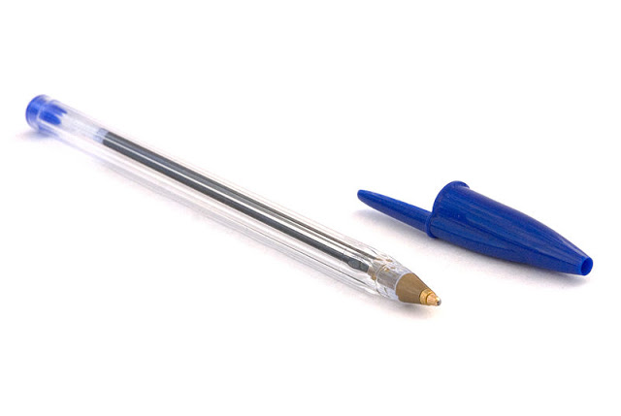
Course overview
Engineering Economics:
Projects:
Technically workable
Financially makes sense
Financial factor:
Engineers need to understand minimum for communication
Example:
production of a ball point pen
Imagine you are an engineer capable of producing a ball point pen
What will you do?

Slide 7
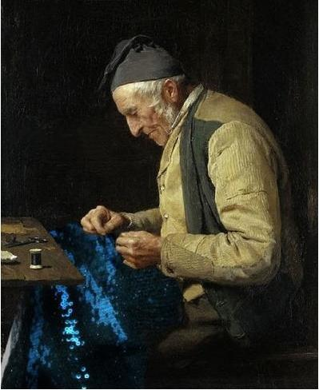
Ball point pen production example: proposal
Pure engineering approach:
Mechanical engineers
Ball tip point
Milling machine
Material science & engineers
Plastic
Metal
Ink
Technically, you can produce it
But how much will it cost?
$1,000? $10,000?

Slide 8
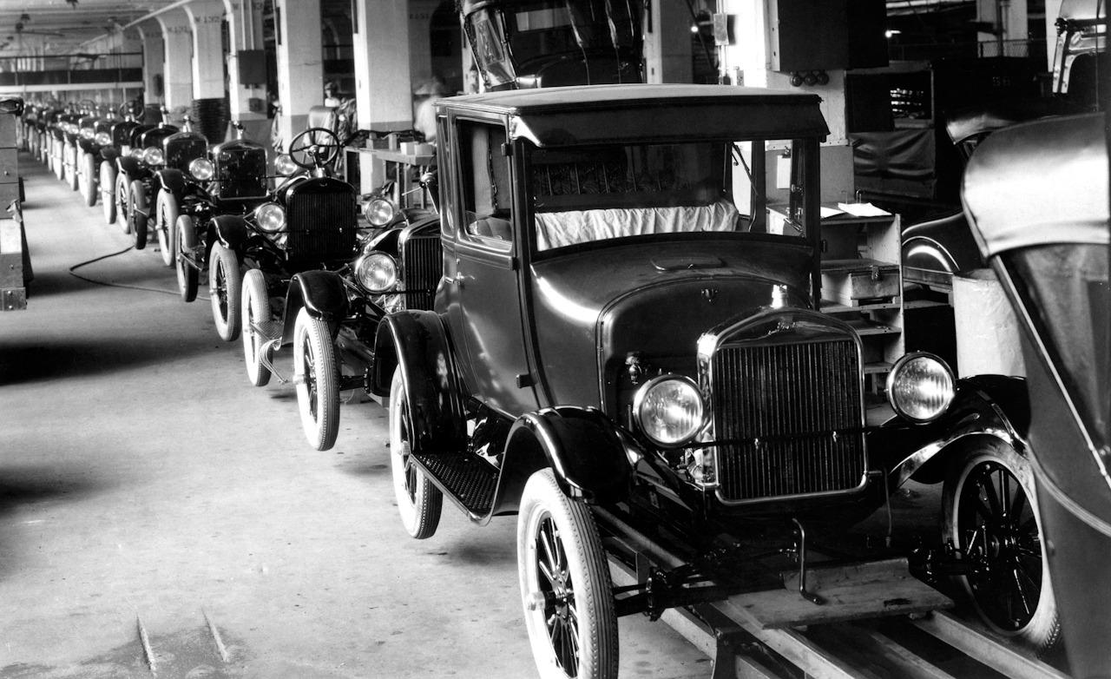
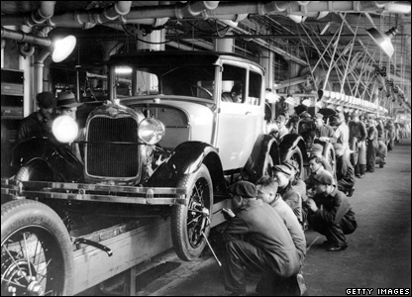
Ball point pen production example: proposal
Now comes in the business people
Lens 1: Cost reduction
Production in factory:
Economy of scale
Plan proposal: Mass production
Build a large factory
Employ workers
Purchase machines:
For milling ball tips, plastic barrel, etc.
And produce a lot:
say 1000 pens per day
Sell them to market: 10 cents per pen

Slide 9
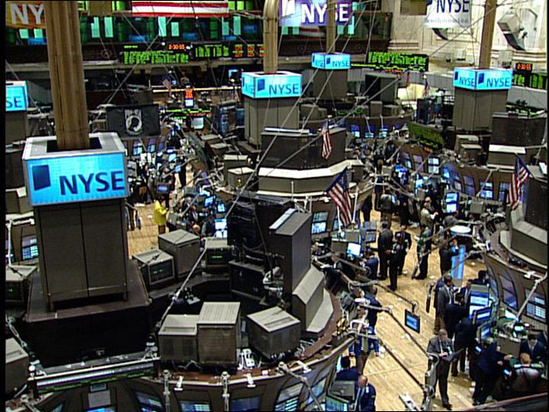
Ball point pen production example: proposal
Lens 2: Investment
But how do we collect the money for the start?
What if this production can make more money?
Incentive for investors!
Then how would you convince your investors?
Prediction for profit
Risk management (beyond our scope!)
Wait, can you be more precise?
Of course profit!
Growth rate
Interest rate
Value in the future
Etc.

Slide 10
Modern market economy
Proposals, proposals, proposals!
Mostly in written forms
You need to show some numbers
Proposal presentations:
Gaming industry:
15 minutes of pitch presentation
Academic conference:
20 minutes of paper presentation
Government funding:
20-60 minutes of proposal presentations
They are all about: does it make sense?
Making payoffs
Minimizing cost

Slide 11
Your role in this market landscape
Engineers:
No need to become a primary role in this proposal making
But need to understand how market works
And the incentive of the investors
Communication between business people
In a broader sense:
Understand how market works
Understand what are the demands out there
Microeconomics:
Theories for economic decision-making behaviors

Slide 12
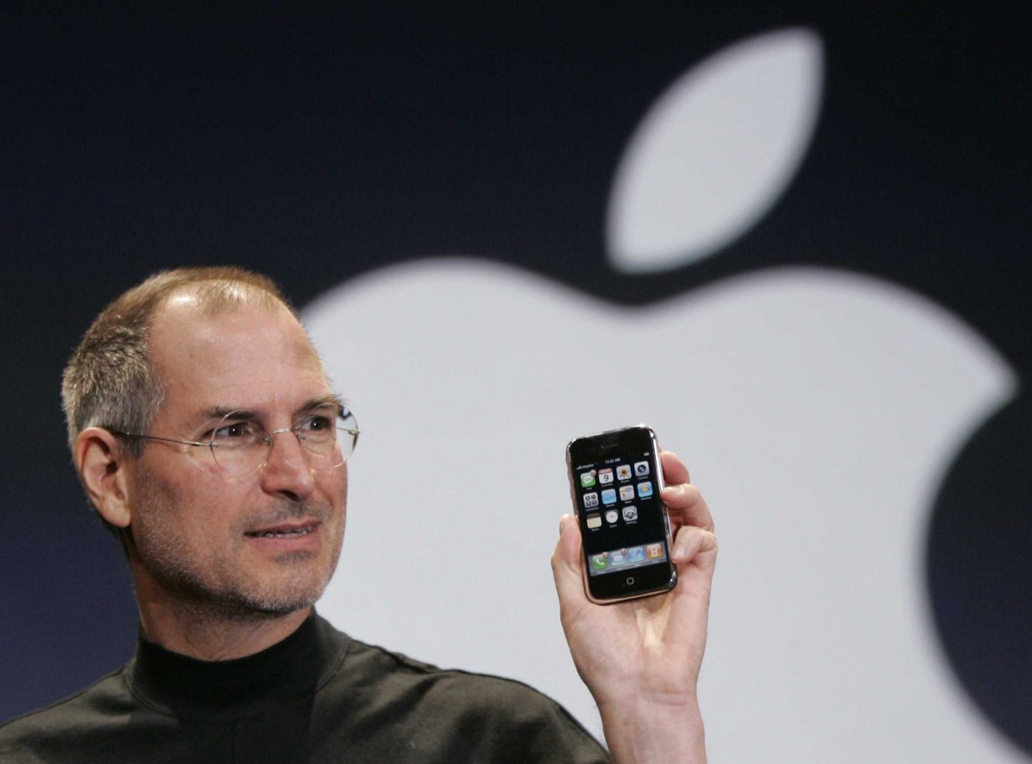
Your role in this market place
Wait, no primary role for engineers/scientists?
New market landscape
Smartphone example
Pure engineering: technically feasible
Programs ready, hardware ready, production easy
Wireless internet ready
Pure business:
Cell phones sell well
Sales of cell phones with internet access, additional features, etc.
Concept of software platform
Steve Jobs and Apple: they understand both
Technology: Identified the need for mobile software platform
Business: Created a new smartphone market
Large user-base of Apple consumers
Contract with AT&T

Slide 13
Back to engineering economics
Big topics:
Making payoffs: profit maximization/cost minimization
Risk management
Understand market systems
For this course, we focus on:
In particular:
Interest rates
Value appreciation/depreciation

Slide 14
Test your current knowledge: A kingdom and a hero
As a hero, you saved a kingdom. The king promised to reward back to you with land. He gives you two choices and you need to pick one. Which one will you choose?
10,000 square miles of land per month
10000, 10000, 10000, …
0.01 square miles for the first month, but doubles up every month
0.01, 0.02, 0.04, 0.08, …
10,000 sq miles
vs.
0.01 sq miles

Slide 15
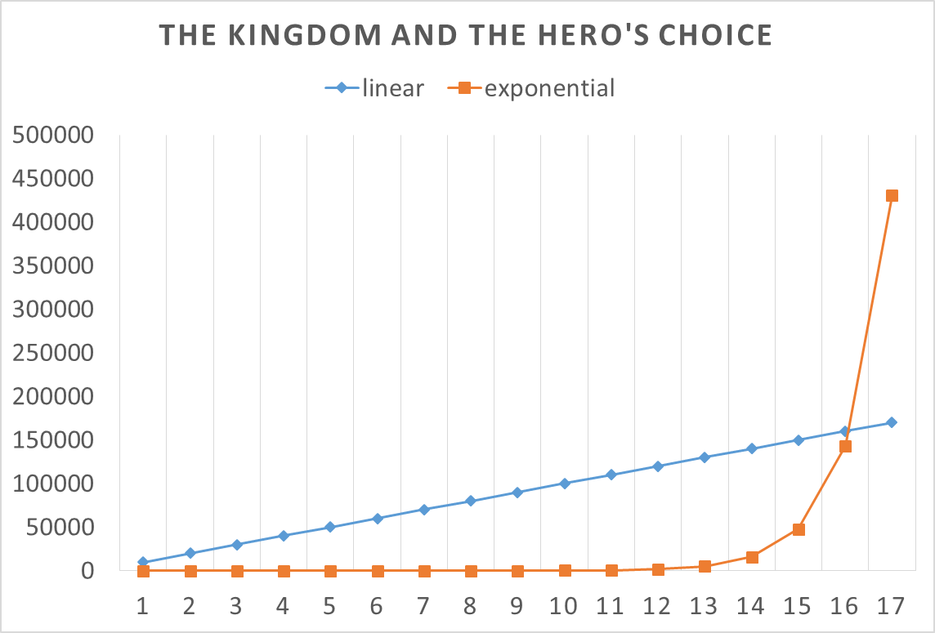
Exponential growth:
What do you think?
Any real-world example?
Credit card
Car loans
Economic growth
National level
Organizational level
Chip design
Moore’s law

Slide 16

Making comparison:
Compare to what? How?
Amount vs. Ratio
Growth of: 1 inch? 2%?
Past year
Now

Slide 17
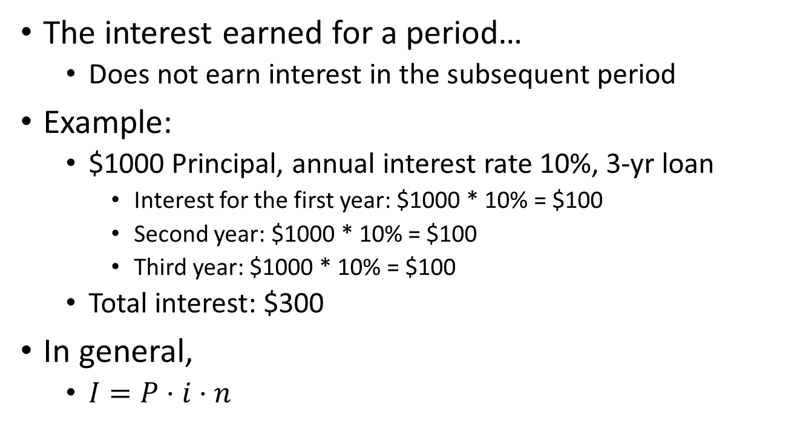
Simple interest
The interest earned for a period…
Does not earn interest in the subsequent period
Example:
$1000 Principal, annual interest rate 10%, 3-yr loan
Interest for the first year: $1000 * 10% = $100
Second year: $1000 * 10% = $100
Third year: $1000 * 10% = $100
Total interest: $300
In general,
$I=P⋅i⋅n$

Slide 18
Compounding interest
Interest earns interest
Interest is added to the principal for the next period
Example:
$1000 Principal, annual interest rate 10%, 3-yr loan
First year: $1000 * 10% = $100
New principal at the end of the year: $1000 + $100 = $1100
Second year: $1100 * 10% = $110
New principal: $1100 + $110 = $1210
Third year: $1210 * 10% = $121
Total interest: $331

Slide 19

Arithmetic series:
$a_{n}=a+\left(n−1\right)⋅d$
$S_{n}$: sum of $a_{n}$?

Slide 20

Geometric series:
$a_{n}=a⋅r^{n−1}$
$S_{n}$: sum of $a_{n}$?

