Slide 1
IET333:
Rate of Return
Benefit-Cost Ratio
Jung-woo Sohn (jzs177@psu.edu)

Slide 2
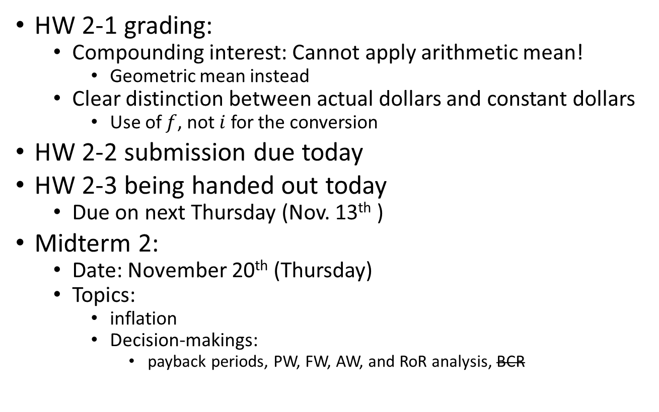
Announcements:
HW 2-1 grading:
  Compounding interest: Cannot apply arithmetic mean!
    Geometric mean instead
  Clear distinction between actual dollars and constant dollars
    Use of $f$, not $i$ for the conversion
HW 2-2 submission due today
HW 2-3 being handed out today
  Due on next Thursday (Nov. 13th )
Midterm 2:
  Date: November 20th (Thursday)
  Topics:
    inflation
    Decision-makings:
      payback periods, PW, FW, AW, and RoR analysis, BCR

Slide 3
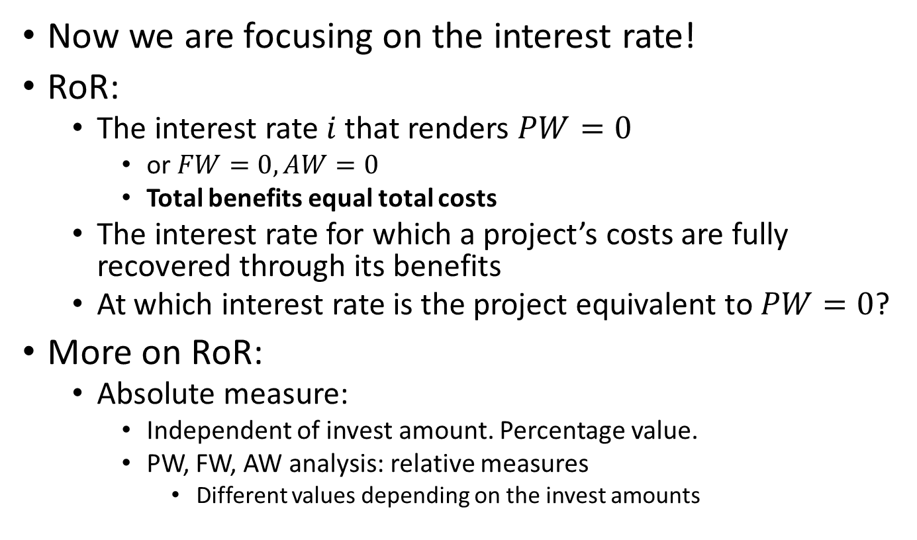
Rate of Return (RoR)
Now we are focusing on the interest rate!
RoR:
  The interest rate $i$ that renders $PW=0$
    or $FW=0, AW=0$
    Total benefits equal total costs
  The interest rate for which a project’s costs are fully recovered through its benefits
  At which interest rate is the project equivalent to $PW=0$?
More on RoR:
  Absolute measure:
    Independent of invest amount. Percentage value.
    PW, FW, AW analysis: relative measures
      Different values depending on the invest amounts

Slide 4
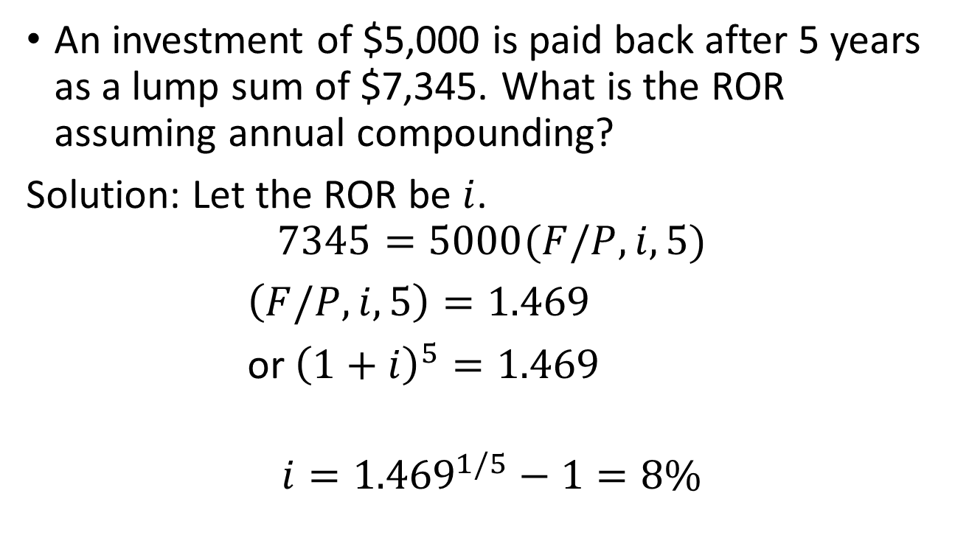
ROR example:
An investment of $5,000 is paid back after 5 years as a lump sum of $7,345. What is the ROR assuming annual compounding?
Solution: Let the ROR be $i$.
$$7345=5000(F/P,i,5)$$
$\left(F/P,i,5\right)=1.469$
or ${\left(1+i\right)}^{5}=1.469$
$$i={1.469}^{1/5}−1=8\%$$

Slide 5
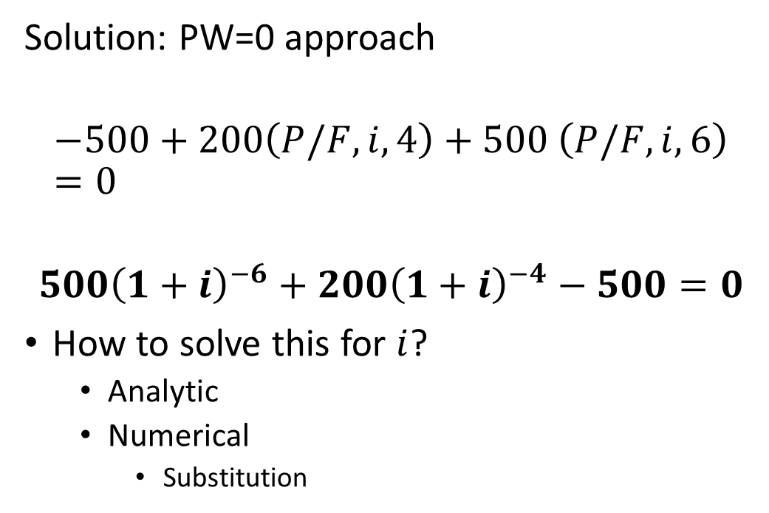
Example 2:
Evaluate ROR for the project with the following cashflow:
Solution: PW=0 approach
$$−500+200\left(P/F,i,4\right)+500 \left(P/F,i,6\right)=0$$
$${500\left(1+i\right)}^{−6}+200{\left(1+i\right)}^{−4}−500=0$$
How to solve this for $i$?
  Analytic
  Numerical
    Substitution

Slide 6

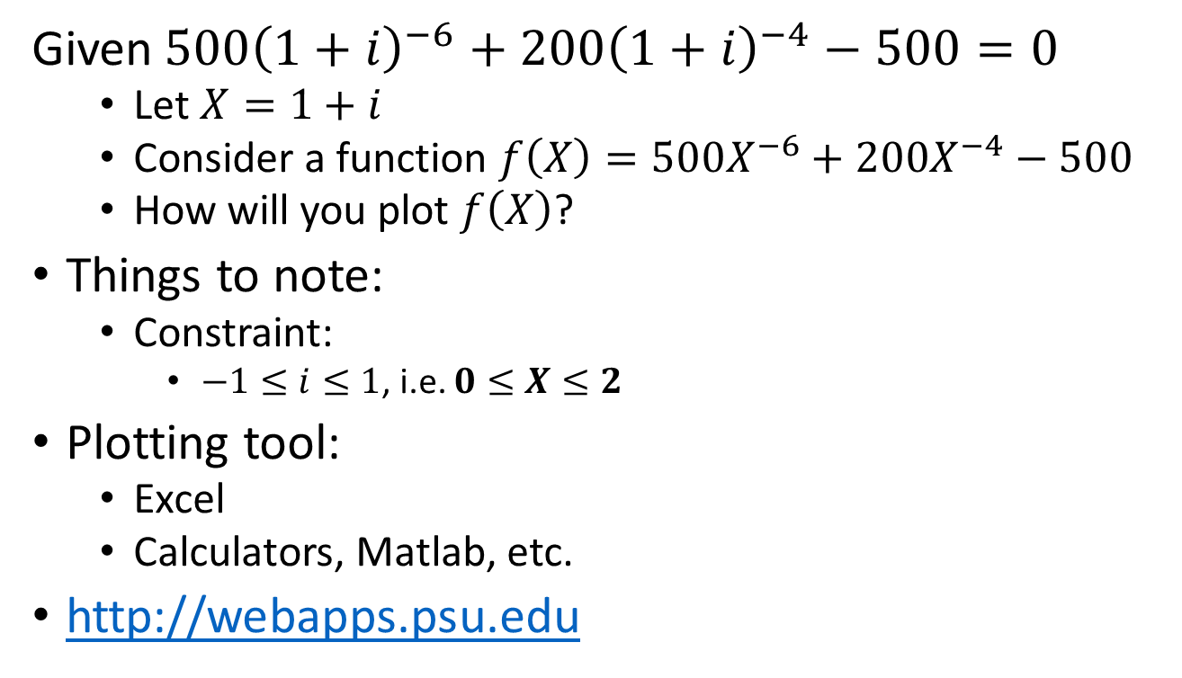
Numerically solving for $i$:
Given${500\left(1+i\right)}^{−6}+200{\left(1+i\right)}^{−4}−500=0$
  Let $X=1+i$
  Consider a function $f\left(X\right)={500X}^{−6}+200X^{−4}−500$
  How will you plot $f\left(X\right)$?
Things to note:
  Constraint:
    $−1≤i≤1$, i.e. $0≤X≤2$
Plotting tool:
  Excel
  Calculators, Matlab, etc.
http://webapps.psu.edu

Slide 7
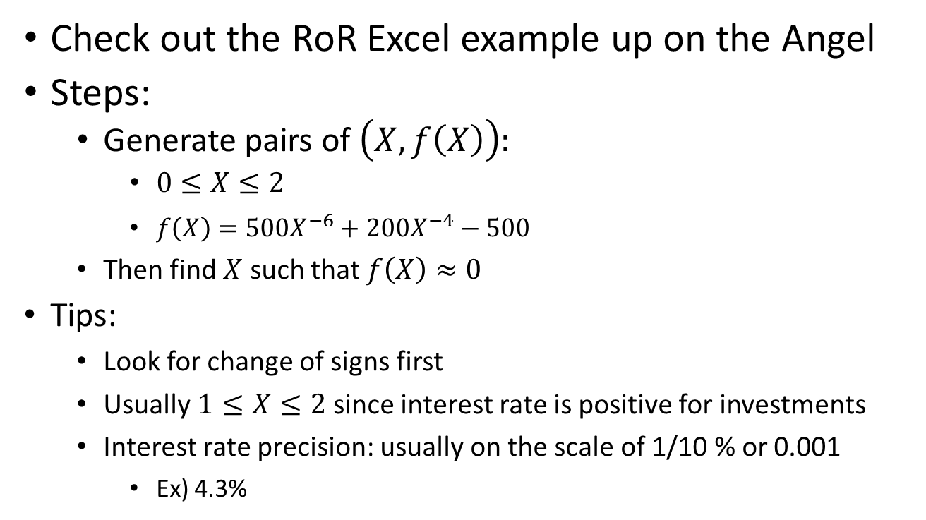
Using Excel
Check out the RoR Excel example up on the Angel
Steps:
  Generate pairs of $\left(X, f\left(X\right)\right):$
    $0≤X≤2$
      $f\left(X\right)={500X}^{−6}+200X^{−4}−500$
    Then find $X$ such that $f\left(X\right)≈0$
  Tips:
    Look for change of signs first
    Usually $1≤X≤2$ since interest rate is positive for investments
    Interest rate precision: usually on the scale of 1/10 % or 0.001
      Ex) 4.3%

Slide 8
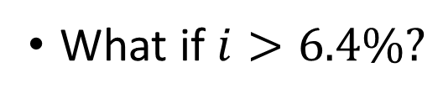
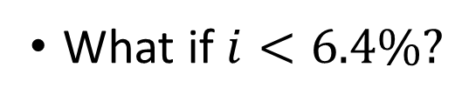
Interpretation of RoR vs. MARR
Answer: RoR for the project is 6.4%
What if $i<6.4\%?$
What if $i>6.4\%?$

Slide 9

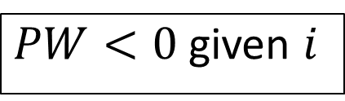
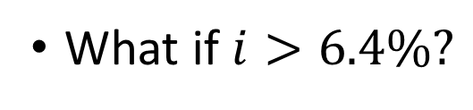
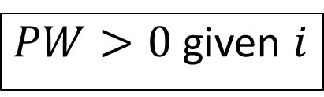
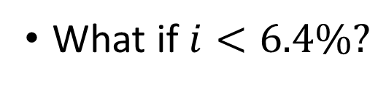
Interpretation of RoR: $PW?$
Given the interest is 6.4% (set to RoR), $PW=0$
What if $i<6.4\%?$
What if $i>6.4\%?$
$PW>0$ given $i$
$PW<0$ given $i$

Slide 10
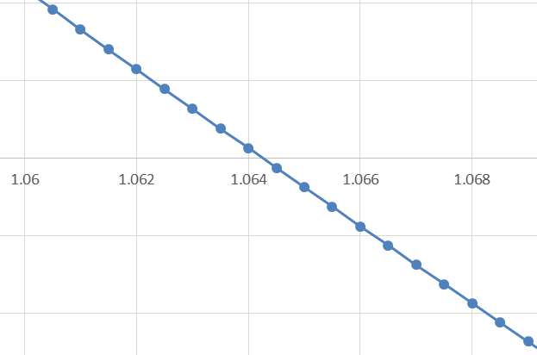
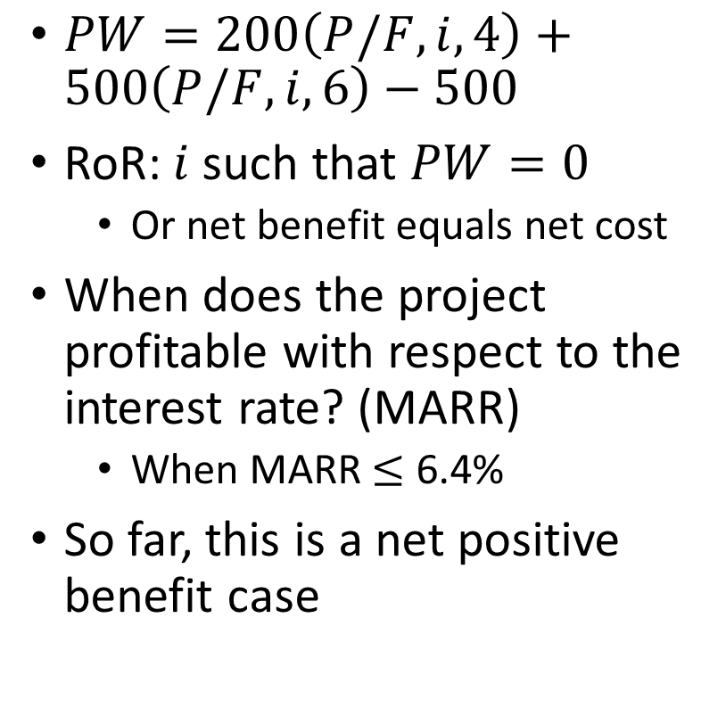
Interpretation of RoR and PW
$PW=200\left(P/F,i,4\right)+500\left(P/F,i,6\right)−500$
RoR: $i$ such that $PW=0$
  Or net benefit equals net cost
When does the project profitable with respect to the interest rate? (MARR)
  When MARR $≤$ 6.4%
So far, this is a net positive benefit case

Slide 11
Comparison with MARR: when the MARR is given
Based on the RoR criterion, should the project be approved for purchase when the managers consider the MARR of the company to be 10%?
  And when MARR is 5%?
When MARR is 10% and this project is rejected based on RoR criteria, what will be the PW?
  PW > 0 or PW < 0?

Slide 12
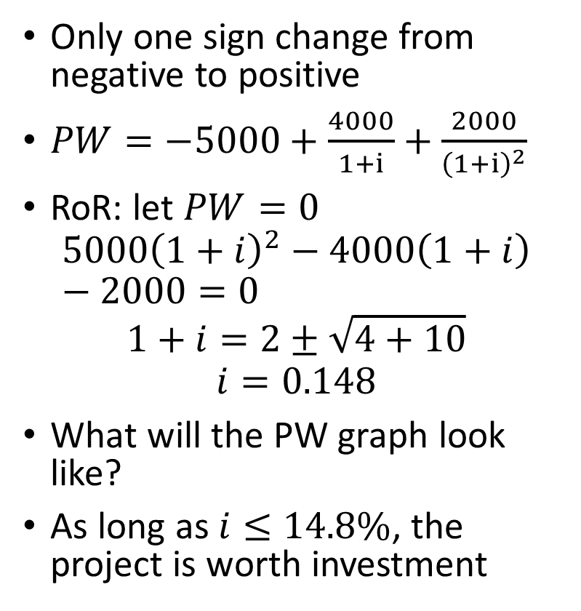
Pure investment case:
Only one sign change from negative to positive
$PW=−5000+\frac{4000}{1+i}+\frac{2000}{{\left(1+i\right)}^{2}}$
RoR: let $PW=0$
$$5000{\left(1+i\right)}^{2}−4000\left(1+i\right)−2000=0$$
$$1+i=2±\sqrt{4+10}$$
$$i=0.148$$
What will the PW graph look like?
As long as $i≤14.8\%$, the project is worth investment

Slide 13
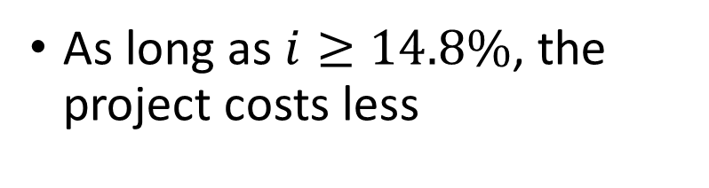
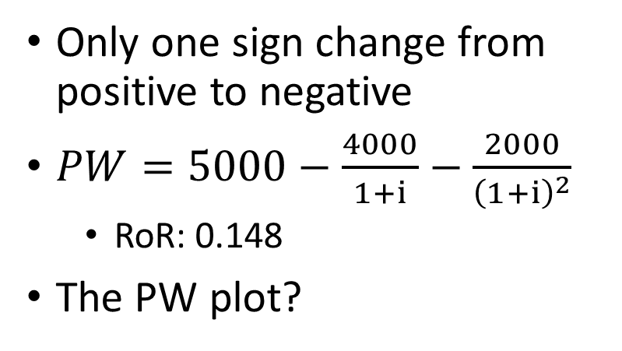
Pure borrowing case:
Only one sign change from positive to negative
$PW=5000−\frac{4000}{1+i}−\frac{2000}{{\left(1+i\right)}^{2}}$
  RoR: 0.148
The PW plot?
As long as $i≥14.8\%$, the project costs less

Slide 14
Hybrid case:
The sign change occurs more than once
Filter out RoR’s depending on the given project constraints

Slide 15
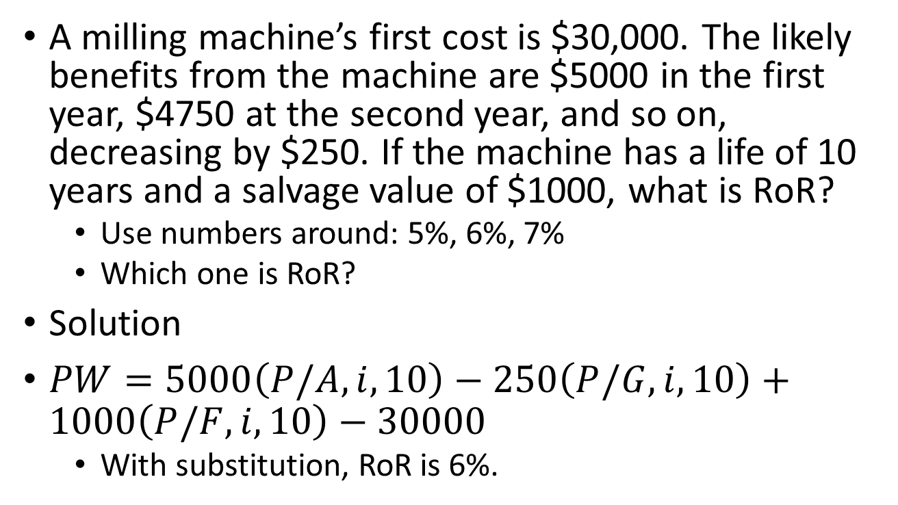
Example: Finding RoR
A milling machine’s first cost is $30,000. The likely benefits from the machine are $5000 in the first year, $4750 at the second year, and so on, decreasing by $250. If the machine has a life of 10 years and a salvage value of $1000, what is RoR?
  Use numbers around: 5%, 6%, 7%
  Which one is RoR?
Solution
$PW=5000\left(P/A, i, 10\right)−250\left(P/G,i,10\right)+1000\left(P/F,i,10\right)−30000$
  With substitution, RoR is 6%.

Slide 16

Example: finding RoR
$PW=5000\left(P/A, i, 10\right)−250\left(P/G,i,10\right)+1000\left(P/F,i,10\right)−30000$
I | (P/A, I, 10) | (P/G, I, 10) | (P/F, I, 10)
5% | 7.722 | 31.652 | .6139
6% | 7.360 | 29.602 | .5584
7% | 7.024 | 27.716 | .5083
5%:
  PW = ?
6%:
  PW = ?
7%:
  PW = ?

Slide 17
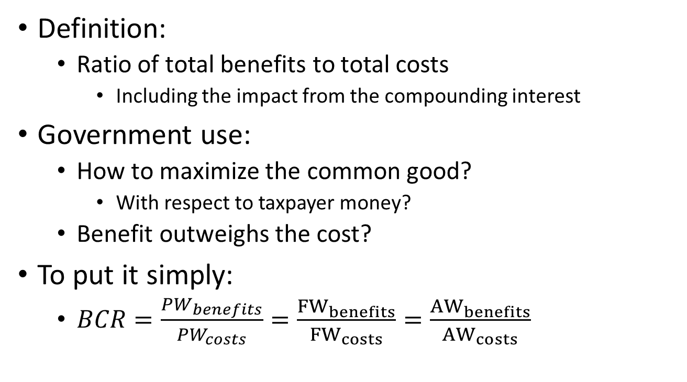
Benefit-Cost ratio
Definition:
  Ratio of total benefits to total costs
    Including the impact from the compounding interest
Government use:
  How to maximize the common good?
    With respect to taxpayer money?
  Benefit outweighs the cost?
To put it simply:
  $BCR=\frac{PW_{benefits}}{PW_{costs}}=\frac{{FW}_{benefits}}{{FW}_{costs}}=\frac{{AW}_{benefits}}{{AW}_{costs}}$

Slide 18
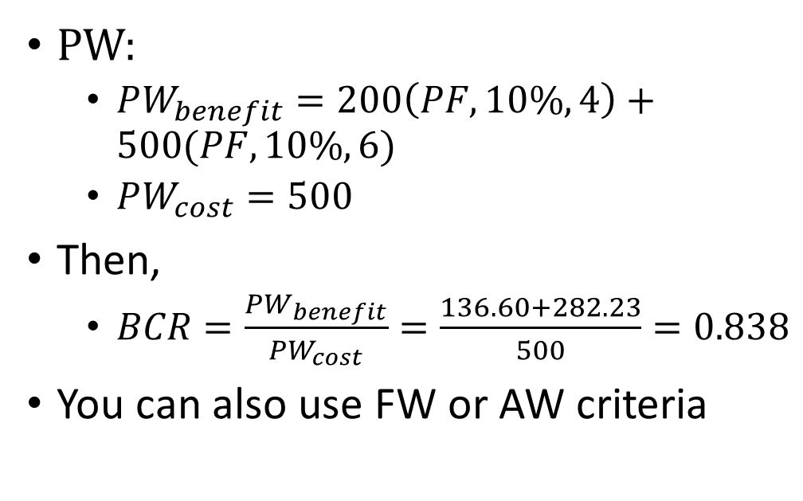
Benefit-cost ratio: example
Assume interest rate of 10%
PW:
  $PW_{benefit}=200\left(PF,10\%,4\right)+500(PF,10\%,6)$
  $PW_{cost}=500$
Then,
  $BCR=\frac{PW_{benefit}}{PW_{cost}}=\frac{136.60+282.23}{500}=0.838$
You can also use FW or AW criteria

Slide 19
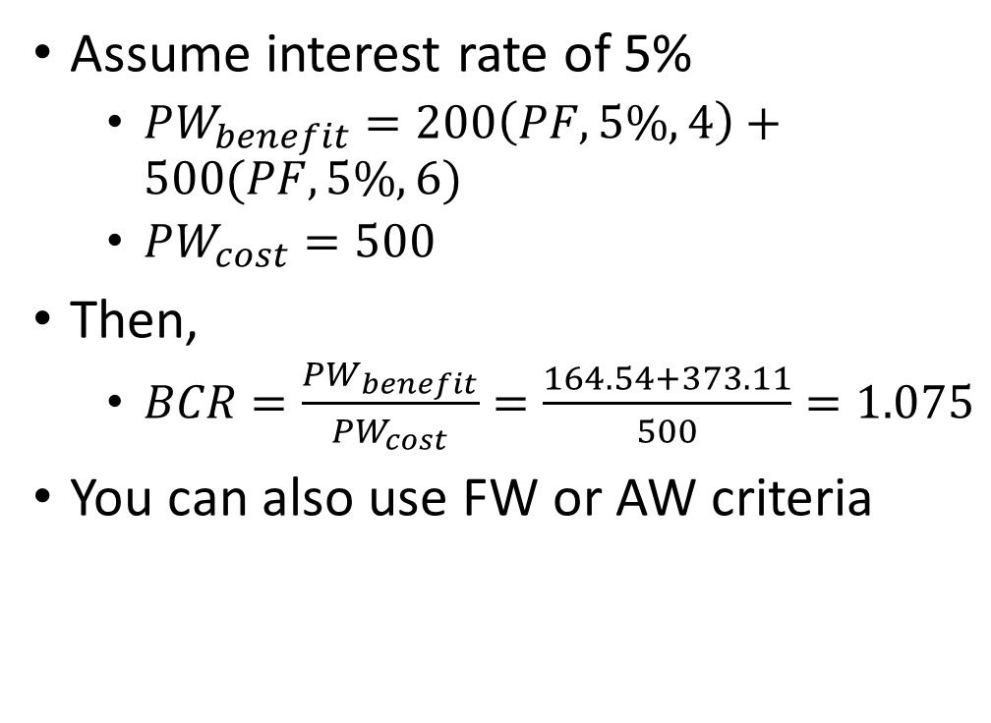
Benefit-cost ratio: relationship to PW, FW, AW criteria
Assume interest rate of 5%
  $PW_{benefit}=200\left(PF,5\%,4\right)+500(PF,5\%,6)$
  $PW_{cost}=500$
Then,
  $BCR=\frac{PW_{benefit}}{PW_{cost}}=\frac{164.54+373.11}{500}=1.075$
You can also use FW or AW criteria

Slide 20
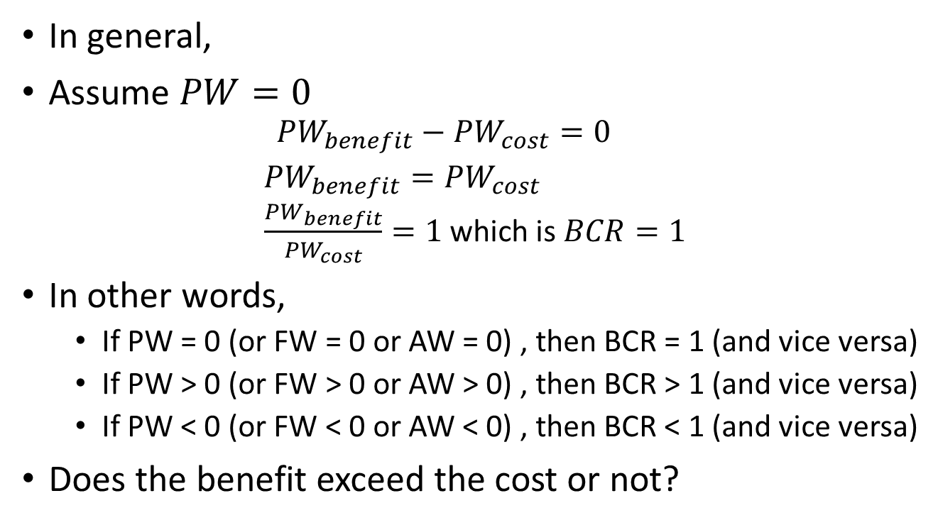
Benefit-cost ratio: relationship to PW, FW, AW criteria
In general,
Assume $PW=0$
  $$PW_{benefit}−PW_{cost}=0$$
  $PW_{benefit}=PW_{cost}$
  $\frac{PW_{benefit}}{PW_{cost}}=1$ which is $BCR=1$
In other words,
  If PW = 0 (or FW = 0 or AW = 0) , then BCR = 1 (and vice versa)
  If PW > 0 (or FW > 0 or AW > 0) , then BCR > 1 (and vice versa)
  If PW < 0 (or FW < 0 or AW < 0) , then BCR < 1 (and vice versa)
Does the benefit exceed the cost or not?

Slide 21
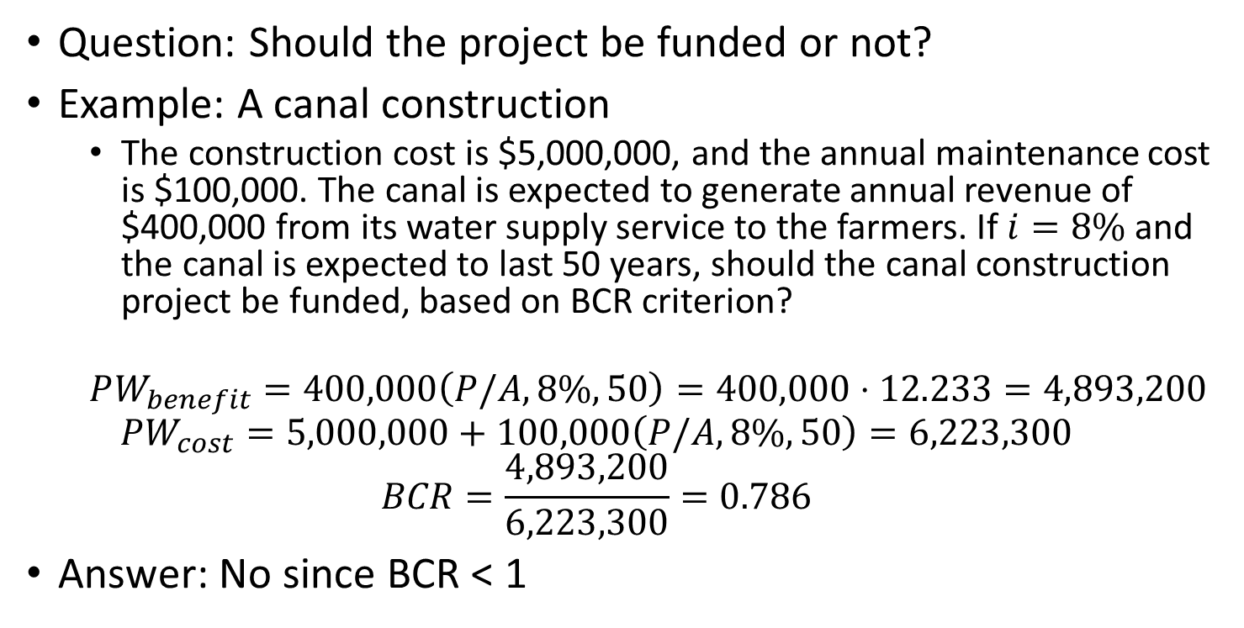
Benefit-cost ratio: example
Question: Should the project be funded or not?
Example: A canal construction
  The construction cost is $5,000,000, and the annual maintenance cost is $100,000. The canal is expected to generate annual revenue of $400,000 from its water supply service to the farmers. If $i=8\%$ and the canal is expected to last 50 years, should the canal construction project be funded, based on BCR criterion?
  $$PW_{benefit}=400,000\left(P/A,8\%,50\right)=400,000⋅12.233=4,893,200$$
  $$PW_{cost}=5,000,000+100,000\left(P/A,8\%,50\right)=6,223,300$$
  $$BCR=\frac{4,893,200}{6,223,300}=0.786$$
Answer: No since BCR < 1

Slide 22
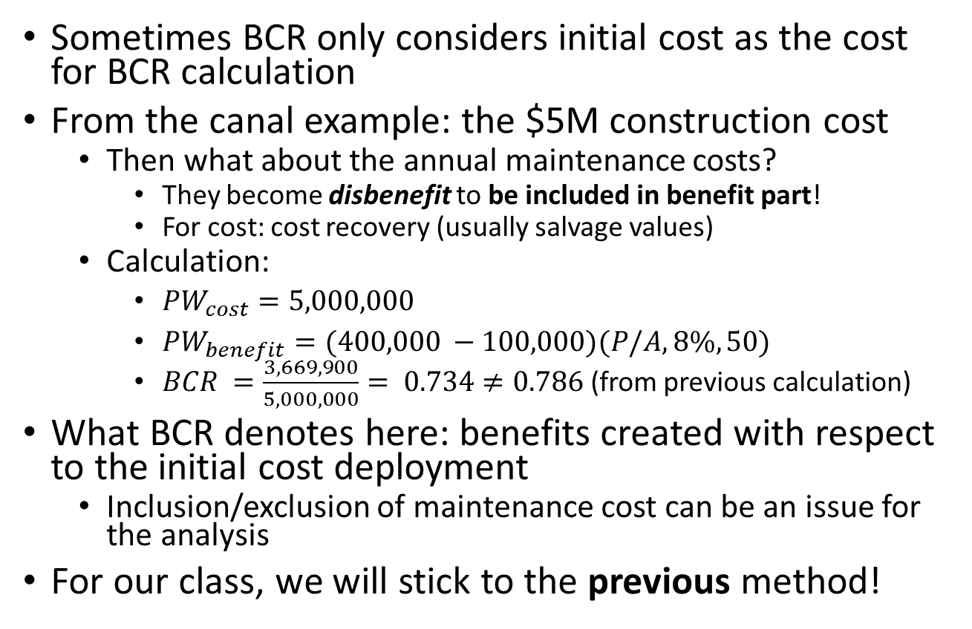
Benefit-cost ratio: Disbenefit
Sometimes BCR only considers initial cost as the cost for BCR calculation
From the canal example: the $5M construction cost
  Then what about the annual maintenance costs?
    They become disbenefit to be included in benefit part!
    For cost: cost recovery (usually salvage values)
  Calculation:
    $PW_{cost}=5,000,000$
    $PW_{benefit}=(400,000 −100,000)(P/A,8\%,50)$
    $BCR =\frac{3,669,900}{5,000,000}= 0.734≠0.786$ (from previous calculation)
What BCR denotes here: benefits created with respect to the initial cost deployment
  Inclusion/exclusion of maintenance cost can be an issue for the analysis
For our class, we will stick to the previous method!

Slide 23
Benefit-cost ratio: PW, FW, AW?
Any choice is fine!
  But AW analysis is good for cases with different project years
    PW and FW analysis: need to use the LCM project year technique
Example:
  Either Robot X or Y can generate $20,000 annually. Robot X costs $50,000 and has a useful life of 7 years and no salvage value. The corresponding data for Robot Y are $40,000, 5 years, and zero. With the interest rate at 8% per year, which one should be selected based on BCR criterion?

Slide 24
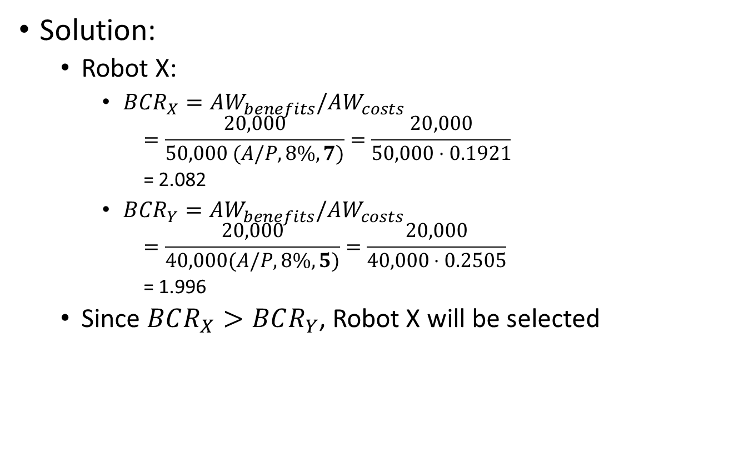
Benefit-cost-ratio: AW example with different project periods
Solution:
  Robot X:
    $BCR_{X}=AW_{benefits}/AW_{costs}$
      $$=\frac{20,000}{50,000 (A/P, 8\%, 7)}=\frac{20,000}{50,000⋅0.1921}$$
      = 2.082
    $BCR_{Y}=AW_{benefits}/AW_{costs}$
      $$=\frac{20,000}{40,000(A/P,8\%, 5)}=\frac{20,000}{40,000⋅0.2505}$$
      = 1.996
  Since $BCR_{X}>BCR_{Y}$, Robot X will be selected

Slide 25
Benefit-cost ratio: drawback of ratio analysis
Compare the two examples: Fixed input/output
  Robot example: same benefit (output)
Benefit
Benefit
Cost
Cost
Project A
Project B
BCR = 1
BCR > 1
This is fixed cost case: costs are the same
Can make comparisons with BCR

Slide 26
Benefit-cost ratio: drawback of ratio analysis
Variable input/output: Project A looks better!
Benefit
Benefit
Cost
Project A
Project B
BCR >>>> 1
BCR > 1

Slide 27



Benefit-cost ratio:
Incremental analysis
Solution: check the increments and find the ratio
Benefit
$$ΔBenefit$$
Benefit
$$ΔCost$$
Cost
Project A
Project B
BCR >>>> 1
BCR > 1
Need to check $ΔBCR_{B−A}\frac{ΔBenefit}{ΔCost}$ instead!

Slide 28
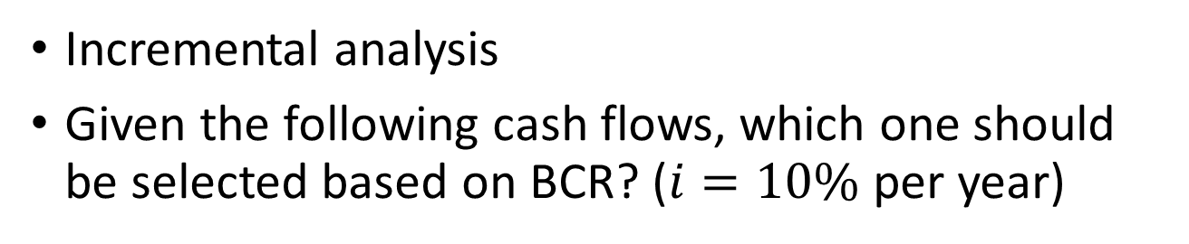
Benefit-cost ratio: Example for incremental analysis
Incremental analysis
Given the following cash flows, which one should be selected based on BCR? ($i=10\%$ per year)
n | Project A | Project B
0 | -$4,500 | -$18,000
1 | 2,000 | 6,500
2 | 2,700 | 9,250
3 | 2,250 | 9,500

Slide 29
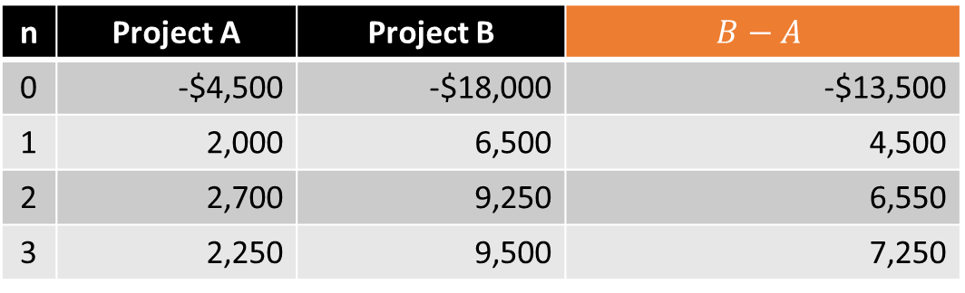
Benefit-cost ratio: Example for incremental analysis
Solution steps:
  Pick a base project (A for this case)
  Find the differences of cashflows (B-A for this case)
n | Project A | Project B | $$B−A$$
0 | -$4,500 | -$18,000 | -$13,500
1 | 2,000 | 6,500 | 4,500
2 | 2,700 | 9,250 | 6,550
3 | 2,250 | 9,500 | 7,250

Slide 30

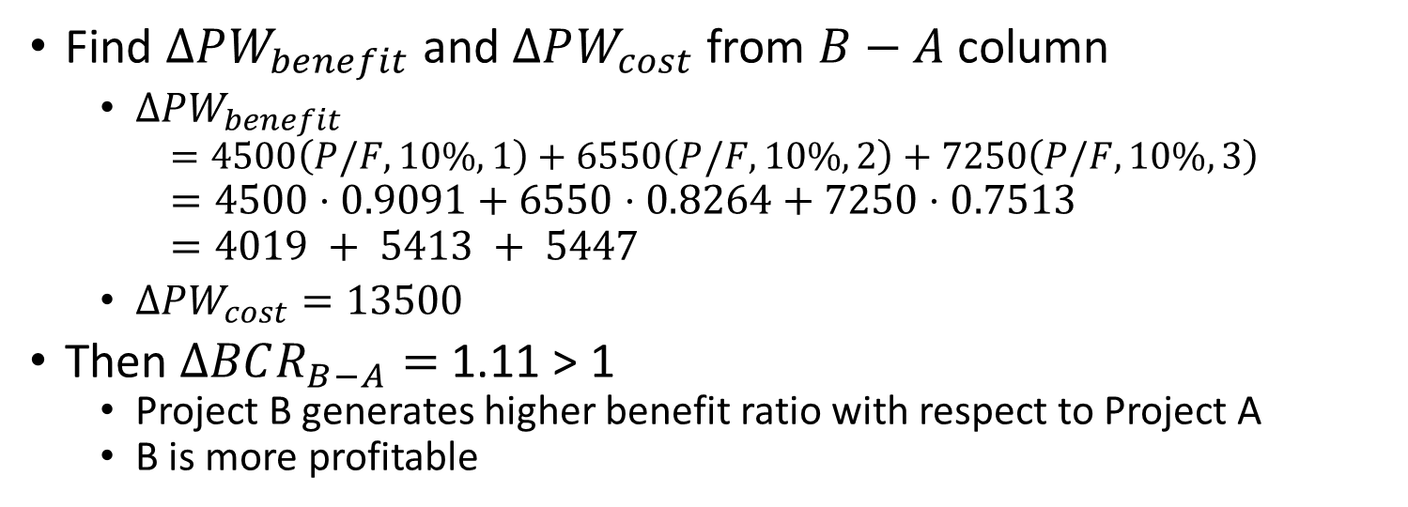
Benefit-cost ratio: Example for incremental analysis
n | Project A | Project B | $$B−A$$
0 | -$4,500 | -$18,000 | -$13,500
1 | 2,000 | 6,500 | 4,500
2 | 2,700 | 9,250 | 6,550
3 | 2,250 | 9,500 | 7,250
Find $ΔPW_{benefit}$ and $ΔPW_{cost}$ from $B−A$ column
  $ΔPW_{benefit}$
    $$=4500\left(P/F,10\%, 1\right)+6550\left(P/F,10\%,2\right)+7250\left(P/F,10\%, 3\right)$$
  $=4500⋅0.9091+6550⋅0.8264+7250⋅0.7513$
  $=4019 + 5413 + 5447$
  $ΔPW_{cost}=13500$
Then $ΔBCR_{B−A}=$ 1.11 > 1
  Project B generates higher benefit ratio with respect to Project A
  B is more profitable

Slide 31
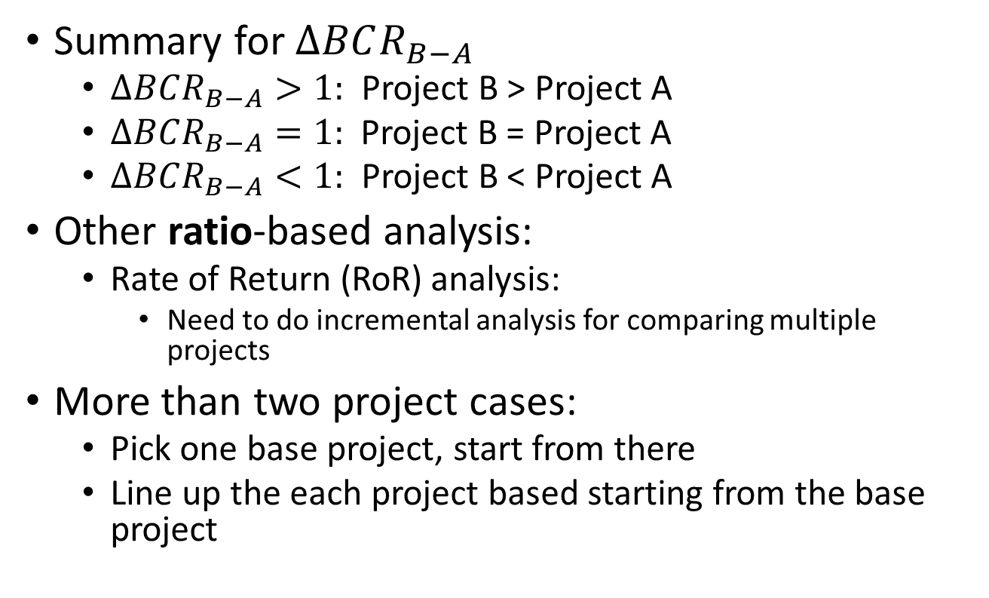
Benefit-cost ratio:
Incremental analysis
Summary for $ΔBCR_{B−A}$
  $ΔBCR_{B−A}>1:$ Project B > Project A
  $ΔBCR_{B−A}=1:$ Project B = Project A
  $ΔBCR_{B−A}<1:$ Project B < Project A
Other ratio-based analysis:
  Rate of Return (RoR) analysis:
    Need to do incremental analysis for comparing multiple projects
More than two project cases:
  Pick one base project, start from there
  Line up the each project based starting from the base project

