Slide 1
IET 333: Depreciation and Taxation
Jung-woo Sohn (jzs177@psu.edu)

Slide 2
Announcements:
No class on next Thursday (December 11th)
Instead, we will have a class time on Wednesday evening (December 10th)
Around 6pm?
Topic: Final review
Pizza will be served!

Slide 3
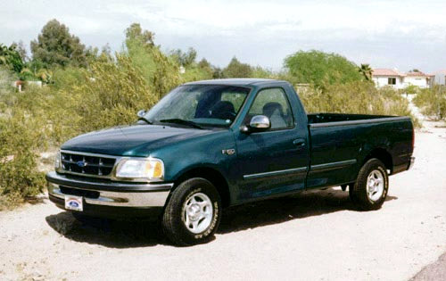
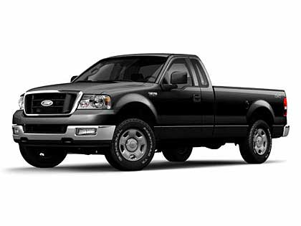
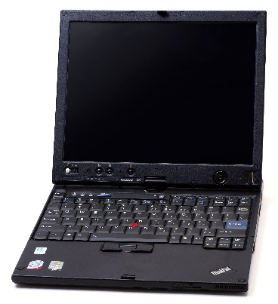
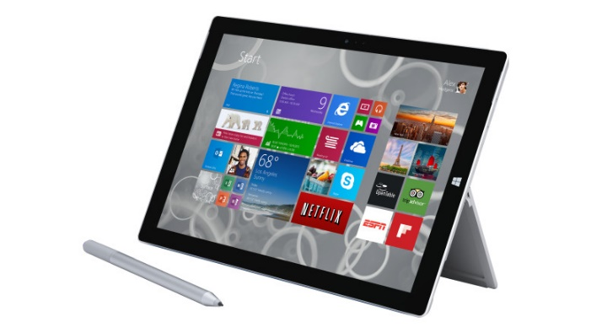
Depreciation
Depreciation:
Decrease in value of an asset
Depreciation caused by:
New products, technological innovations, etc.
Usually capital equipment
Machinery
Depreciation amount:
Determined by the market
Or your own estimation/prediction

Slide 4
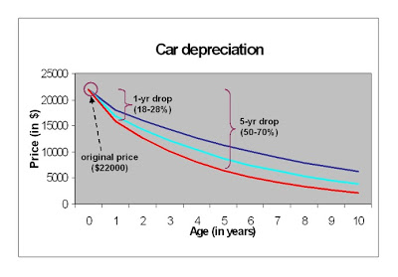
Depreciation example: Used car value example
Source: http://livingstingy.blogspot.com/2012/04/cars-with-low-depreciation-self.html

Slide 5
Depreciation: Terminology
Asset
Resource used in business
Useful life
Duration of time resources are expected to be in use
Market value
The value what the asset can be disposed of at the time of sale
Book value: prediction/estimation
The value what the owner needs to sell (to avoid a loss)
Starts from the first cost
Relationship to tax:
Depreciation is regarded to contribute to the production of goods
Non-taxable

Slide 6
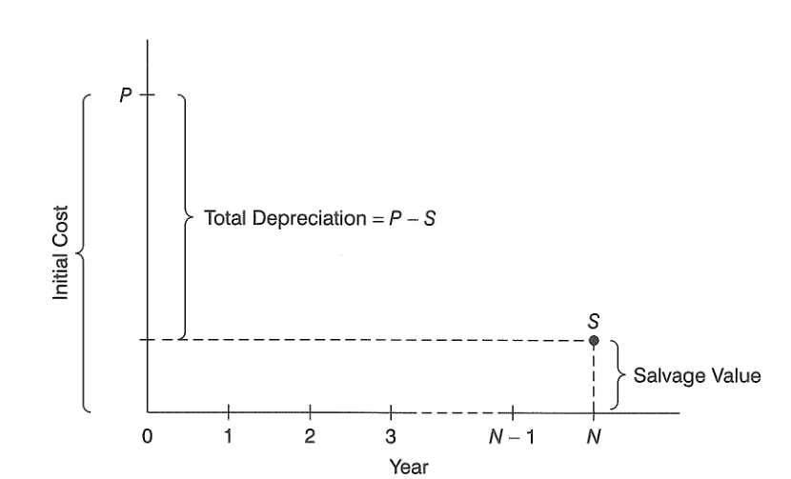
Depreciation: terminology

Slide 7
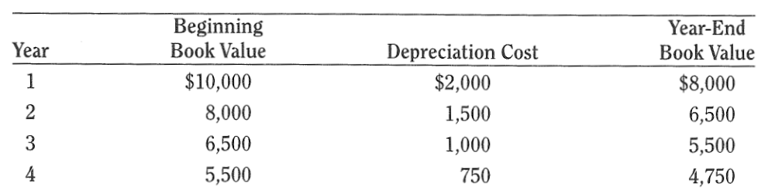
Depreciation: terminology
Depreciation cost: accumulates over the years

Slide 8
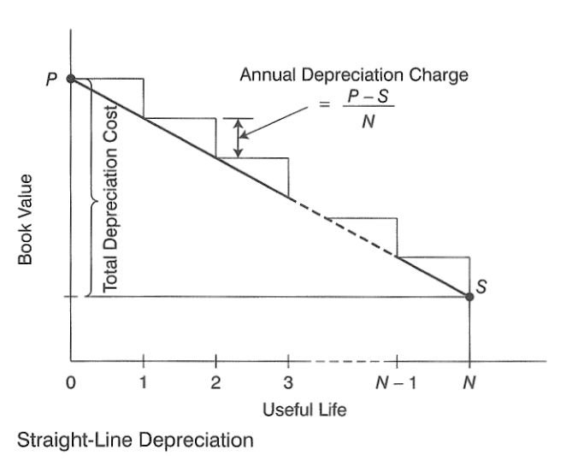
Depreciation: Straight-line depreciation
Same depreciation cost every year:
Total depreciation: P – S
Annual depreciation:
(P – S) / N

Slide 9
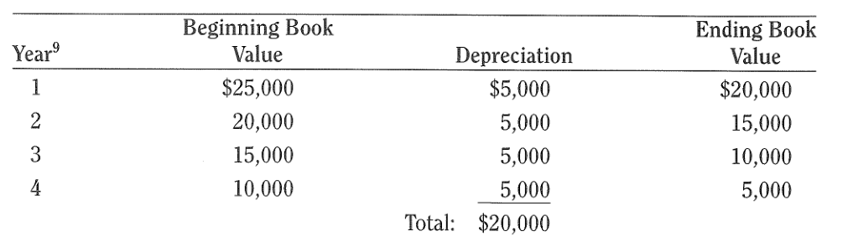
Depreciation: Straight-line depreciation
Example: A robot costs $25,000. At the end of four-year useful life its salvage value is estimated to be $5,000. Prepare its depreciation schedule under the straight-line method.
P = $25,000, S = $5,000, N = 4
Therefore, annual depreciation: (25,000 – 5,000) / 4 = 5,000

Slide 10
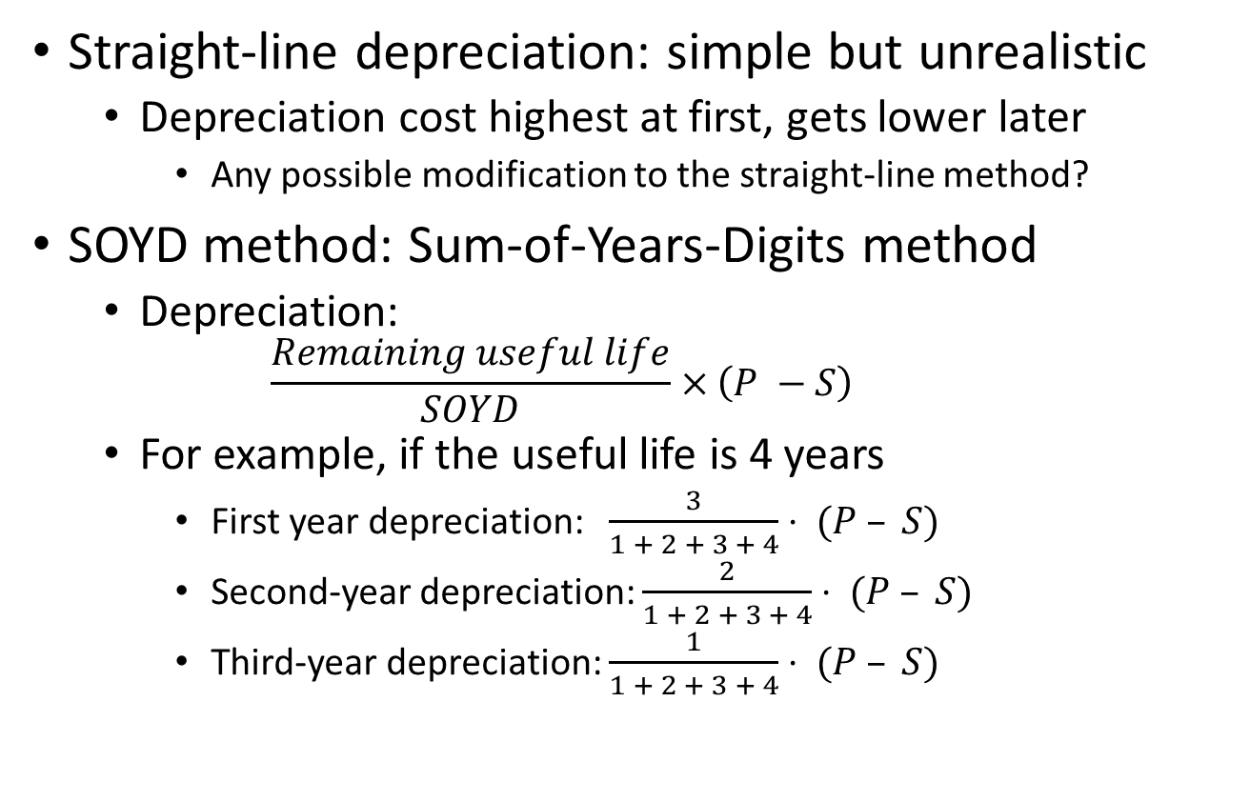
Depreciation: SOYD method
Straight-line depreciation: simple but unrealistic
Depreciation cost highest at first, gets lower later
Any possible modification to the straight-line method?
SOYD method: Sum-of-Years-Digits method
Depreciation:
$$\frac{Remaining useful life}{SOYD}×\left(P −S\right)$$
For example, if the useful life is 4 years
First year depreciation: $\frac{3}{1 + 2 + 3 + 4}⋅ (P – S)$
Second-year depreciation: $\frac{2}{1 + 2 + 3 + 4}⋅ (P – S)$
Third-year depreciation: $\frac{1}{1 + 2 + 3 + 4}⋅ (P – S)$

Slide 11
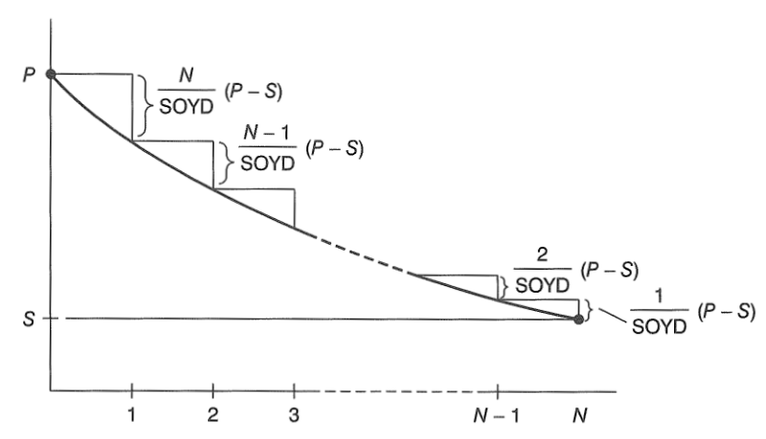
Depreciation: Declining balance with SOYD method

Slide 12
Depreciation: SOYD method
Example: A robot costs $25,000. At the end of four-year useful life its salvage value is estimated to be $5,000. Prepare its depreciation schedule under the SOYD method.
SOYD = 1 + 2 + 3 + 4 = 10 years
P – S = 25,000 – 5,000 = 20,000
Depreciation rates:
1st year: 4/10
2nd year: 3/10
3rd year: 2/10
4th year: 1/10
Depreciations:
1st year: 4/10 * 20,000
2nd year:3/10 * 20,000
3rd year: 2/10 * 20,000
4th year: 1/10 * 20,000

Slide 13
Depreciation: SOYD method
Example: A robot costs $25,000. At the end of four-year useful life its salvage value is estimated to be $5,000. Prepare its depreciation schedule under the SOYD method.
Year | Beginning Book Value | Depreciation | Ending Book Value
1 | $25,000 | 20,000 * 0.4 = 8,000 | $17,000
2 | 17,000 | 20,000 * 0.3 = 6,000 | 11,000
3 | 11,000 | 20,000 * 0.2 = 4,000 | 7,000
4 | 7,000 | 20,000 * 0.1 = 2,000 | 5,000
 |  | Total: 20,000

Slide 14
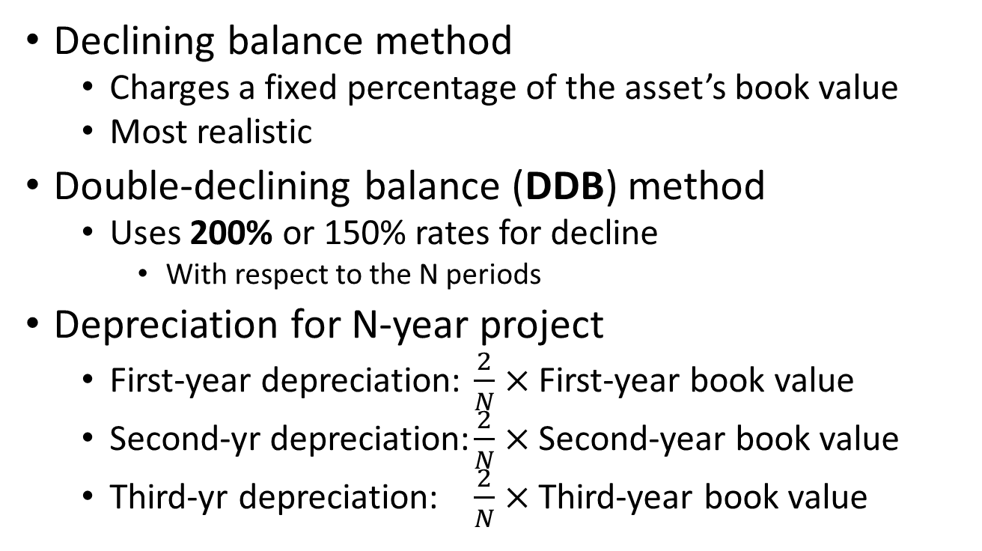
Depreciation: Double-declining balance method
Declining balance method
Charges a fixed percentage of the asset’s book value
Most realistic
Double-declining balance (DDB) method
Uses 200% or 150% rates for decline
With respect to the N periods
Depreciation for N-year project
First-year depreciation: $\frac{2}{N}×$ First-year book value
Second-yr depreciation: $\frac{2}{N}×$ Second-year book value
Third-yr depreciation: $\frac{2}{N}×$ Third-year book value

Slide 15
Depreciation: DDB method
Example: A robot costs $25,000. At the end of four-year useful life its salvage value is estimated to be $5,000. Prepare its depreciation schedule under the DDB method.
Depreciation rate: 2/N = 2/4 = 0.5
Year | Beginning book value | Depreciation | Ending book value
1 | $25,000 | $12,500 = $25,000 * 0.5 | $12,500 = $25,000 - $12,500
2 | 12,500 | 6,250 = 12,500 * 0.5 | 6,250 = 12,500 – 6,250
3 | 6,250 | 3,125 = 6,250 * 0.5 | 3,125 = 6,250 – 3,125
4 | 3,125 | 1,563 = 3,125 * 0.5 | 1,562 = 3,125 – 1,563
 |  | Total = $23,438
Ending book balance: 1562 < 5000?????

Slide 16
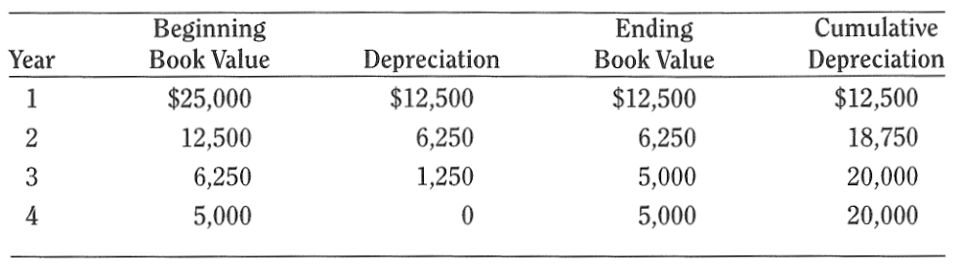
Depreciation: DDB method
How to compensate the loss below the salvage value estimation?
Stop applying DDB at certain points
Switch to straight-line method in the middle

Slide 17
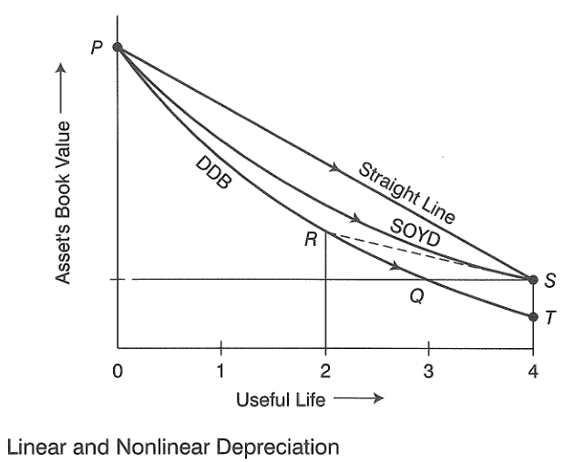
Depreciation: Switching to linear depreciation

Slide 18
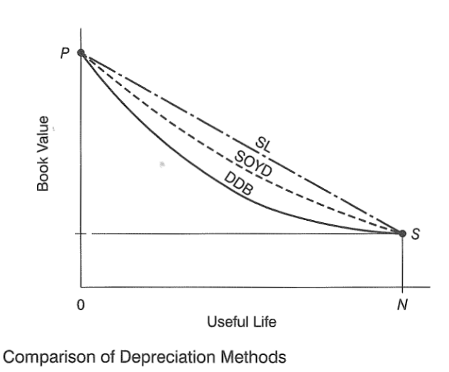
Depreciation: Comparison of different methods

Slide 19
Depreciation: Accelerated cost recovery system (ACRS)
Why ACRS?
To tackle the cons of the depreciation methods so far
SYOD: Depreciation is not realistic
DDB: Depreciation realistic but problem with the salvage value
The idea for ACRS:
Consider a set of depreciation rates with
Accelerated decline
Converging to the estimated salvage value
MACRS (Modified Accelerated Cost Recovery System)

Slide 20
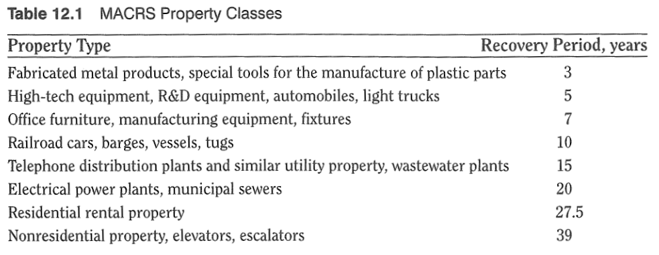
Depreciation: MACRS (Modified Accelerated Cost Recovery System)
Depreciation categories and rates predetermined
Usually by the government

Slide 21
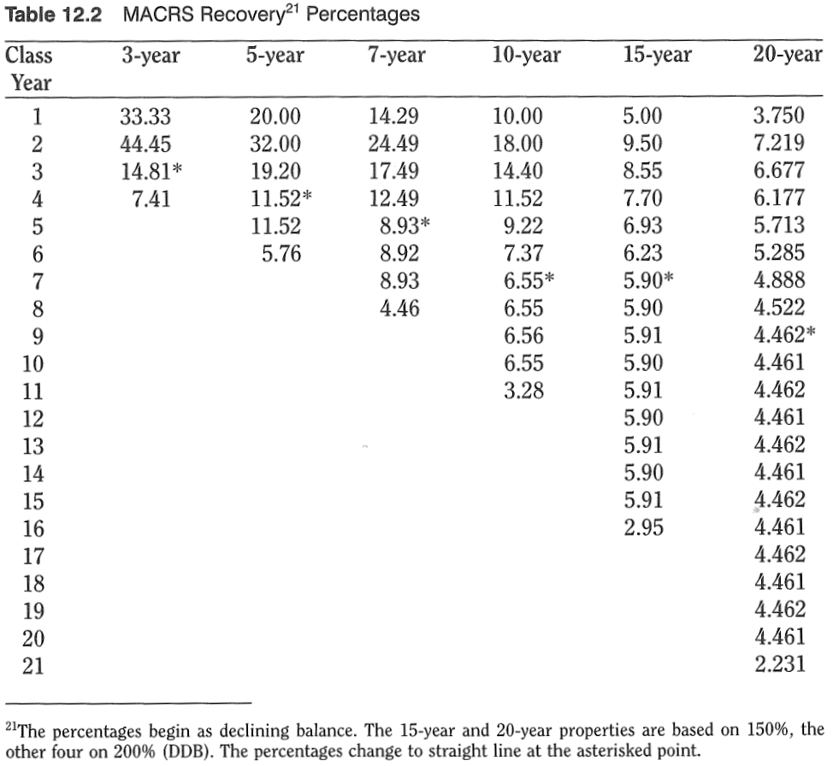

Slide 22
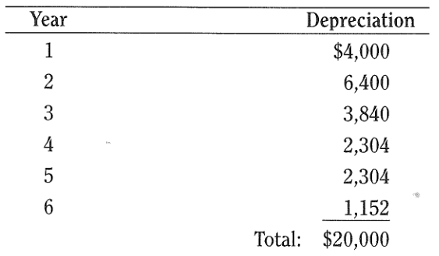
Depreciation: MACRS example
Determine the depreciation schedule for a $20,000 workstation computer as per MACRS.
Category: 5-year one
Rates: Look up in the MACRS table

Slide 23
Tax: taking out depreciation cost
In corporate tax…
Gross income = Sales revenue – operating cost
Taxable income = Gross income – Depreciation expenditures
Depreciation is regarded as directed to production
Incremental tax rate: for corporates
Tax amount for $60,000 income
10% for the first $50,000 = $5,000
15% for the remaining $10,000 = $1,500
Total amount of tax: $6,500
Taxable Income | Rate
Up to $50,000 | 10%
$50,000 - $75,000 | 15%
$75,000 - $100,000 | 20%
Beyond $100,000 | 25%
Notes:
P339

Slide 24
Tax: example
A small job shop’s revenue for the last year was $782,552, while its operating costs were $458,760. The shop acquired a new CAM system for its numerically controlled machines at a cost of $125,000. The CAM system’s useful life is expected to be three years and the salvage value is $20,000. Assuming straight-line depreciation, how much income tax is due? (Use the tax rate table from the previous slide)

Slide 25
Tax: example
Solution:
Gross income = Sales revenue – Operating cost
= 782,552 – 458,760
= 323,792
Taxable income = Gross income – Depreciation expense
= 323,792 – (125,000 – 20,000) / 3
= 323,792 – 35,000
= 288,792
Application of tax rates: incremental
10% up to $50,000: = 5,000
15% up to additional $25,000: = 3,750
20% up to additional $25,000: = 5,000
25% for the remaining $188,792: = 47,198
And sum them up!
The income tax due is $60,948

