Slide 1
IET 333: Week 3
Jung-woo Sohn (jzs177@psu.edu)
College of Information Sciences and Technology
The Pennsylvania State University

Slide 2
Announcement:
Syllabus update:
Exams: 70%, others: 30%
Office hour: Th 1:30pm – 2:30pm

Slide 3
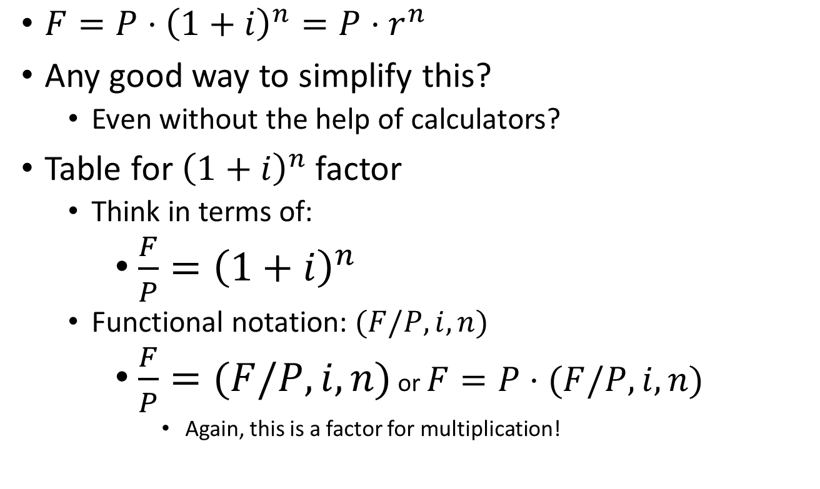
Functional notation method
$F=P⋅{\left(1+i\right)}^{n}=P⋅r^{n}$
Any good way to simplify this?
Even without the help of calculators?
Table for ${\left(1+i\right)}^{n}$ factor
Think in terms of:
$\frac{F}{P}={\left(1+i\right)}^{n}$
Functional notation: $(F/P,i,n)$
$\frac{F}{P}=(F/P,i,n)$ or $F=P⋅(F/P,i,n)$
Again, this is a factor for multiplication!

Slide 4
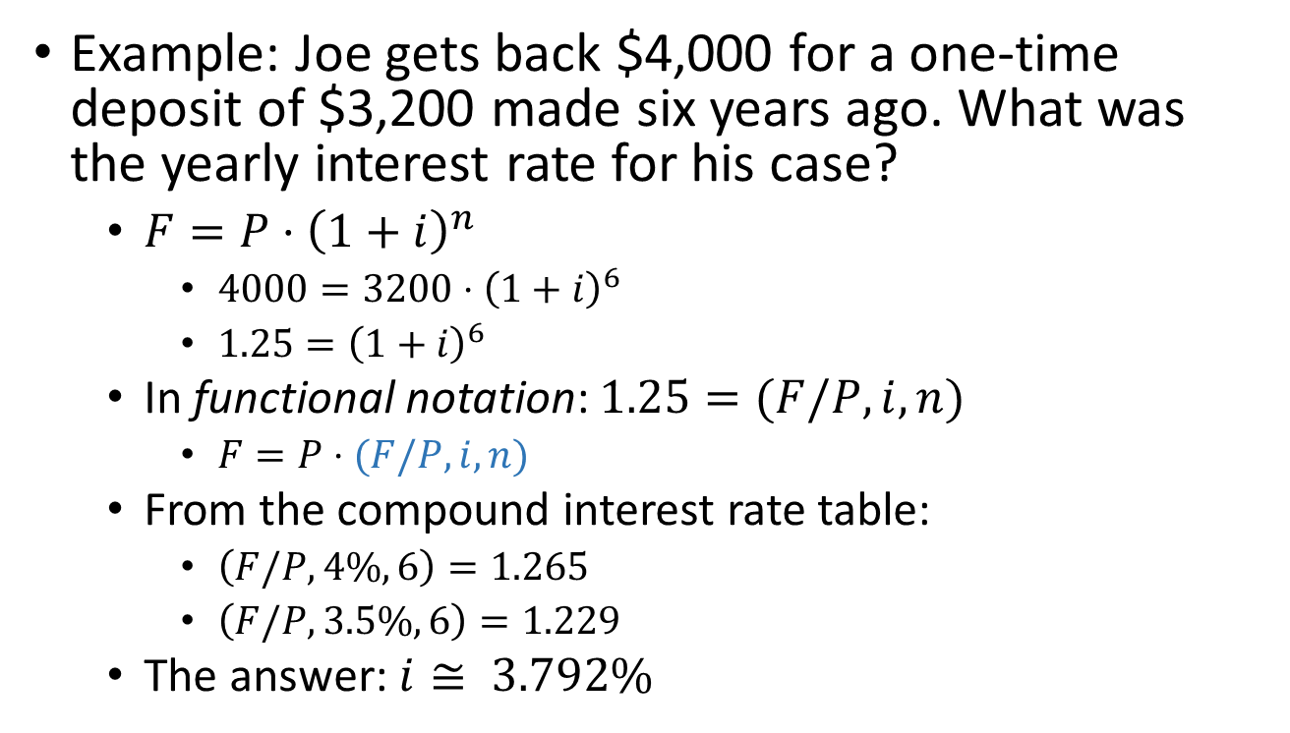
Interpolation:
Example: Joe gets back $4,000 for a one-time deposit of $3,200 made six years ago. What was the yearly interest rate for his case?
$F=P⋅{\left(1+i\right)}^{n}$
$4000=3200⋅{\left(1+i\right)}^{6}$
$1.25={\left(1+i\right)}^{6}$
In functional notation: $1.25=(F/P,i,n)$
$F=P⋅(F/P,i,n)$
From the compound interest rate table:
$\left(F/P,4\%,6\right)=1.265$
$\left(F/P,3.5\%,6\right)=1.229$
The answer: $i≅ 3.792\%$

Slide 5
Interpolation: Use similarity in triangles:

Slide 6
Interpolation: Use similarity in triangles:

Slide 7
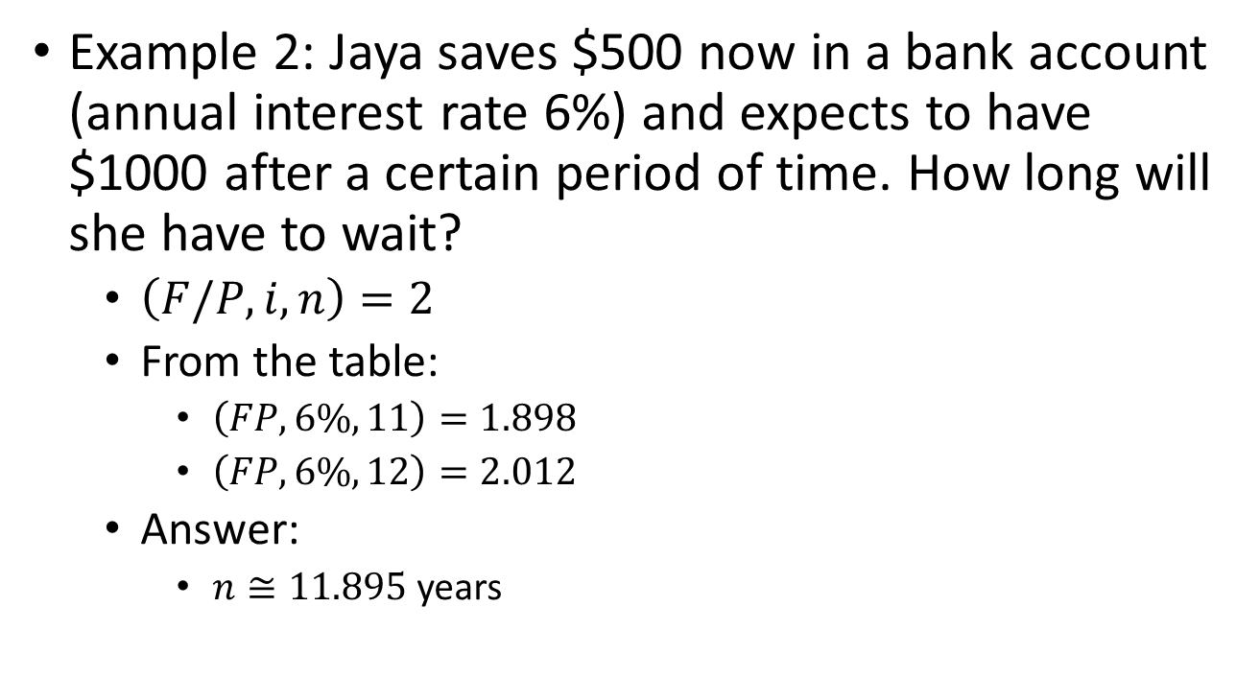
Interpolation:
Example 2: Jaya saves $500 now in a bank account (annual interest rate 6%) and expects to have $1000 after a certain period of time. How long will she have to wait?
$\left(F/P,i,n\right)=2$
From the table:
$\left(FP,6\%,11\right)=1.898$
$\left(FP,6\%,12\right)=2.012$
Answer:
$n≅11.895$ years

Slide 8
Interpolation: Use similarity in triangles:

Slide 9
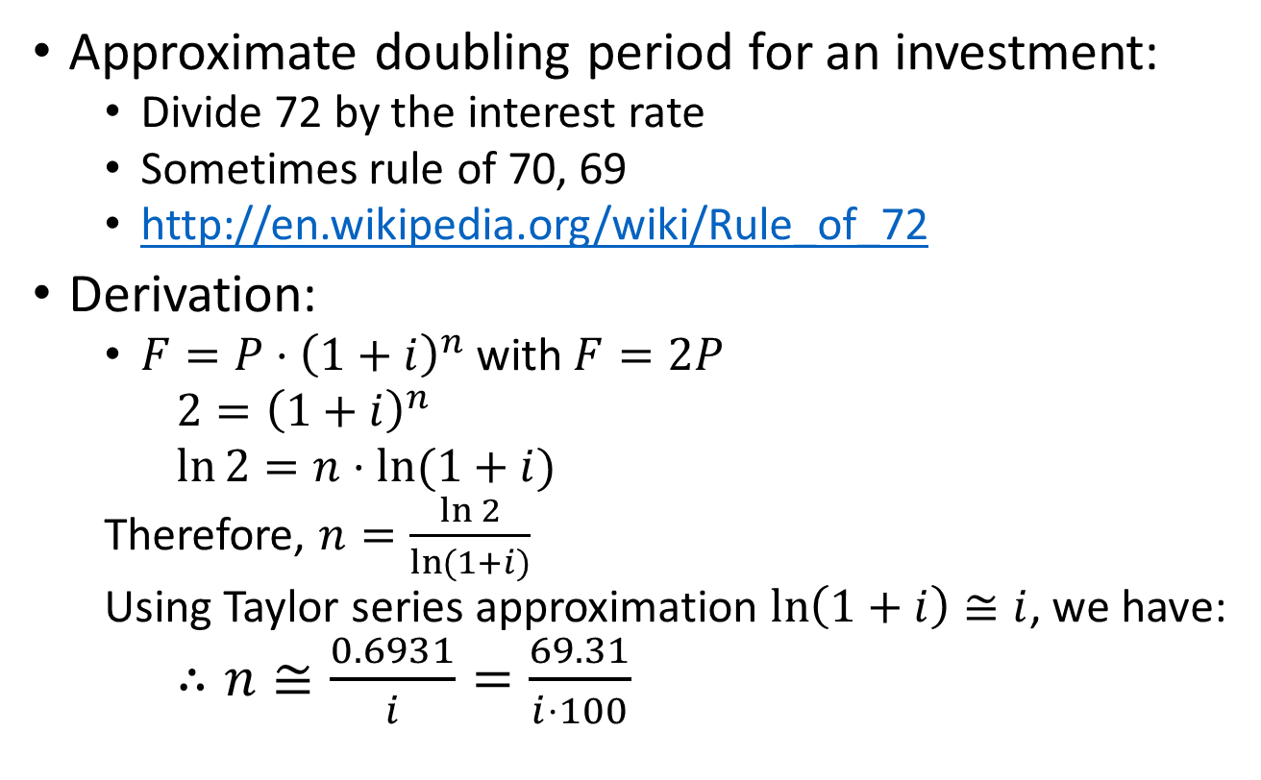
More on doubling time: Rule of 72
Approximate doubling period for an investment:
Divide 72 by the interest rate
Sometimes rule of 70, 69
http://en.wikipedia.org/wiki/Rule_of_72
Derivation:
$F=P⋅{\left(1+i\right)}^{n}$ with $F=2P$
$2={\left(1+i\right)}^{n}$
$\ln{2=n⋅ln⁡(1+i)}$
Therefore, $n=\frac{\ln{2}}{\ln{(1+i)}}$
Using Taylor series approximation $\ln\left(1+i\right)≅i$, we have:
$∴n≅\frac{0.6931}{i}=\frac{69.31}{i⋅100}$

Slide 10
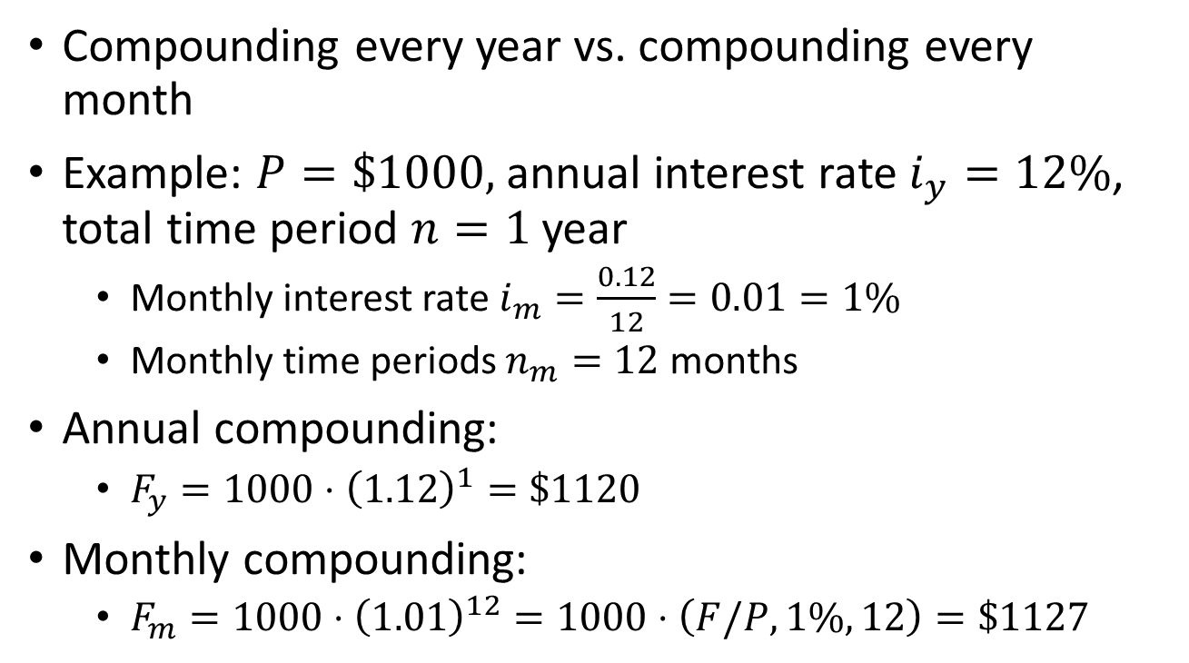
Compounding period:
Compounding every year vs. compounding every month
Example: $P=\$1000,$annual interest rate $i_{y}=12\%$, total time period $n=1$ year
Monthly interest rate $i_{m}=\frac{0.12}{12}=0.01=1\%$
Monthly time periods $n_{m}=12$ months
Annual compounding:
$F_{y}=1000⋅{\left(1.12\right)}^{1}=\$1120$
Monthly compounding:
$F_{m}=1000⋅{\left(1.01\right)}^{12}=1000⋅\left(F/P,1\%,12\right)=\$1127$

Slide 11
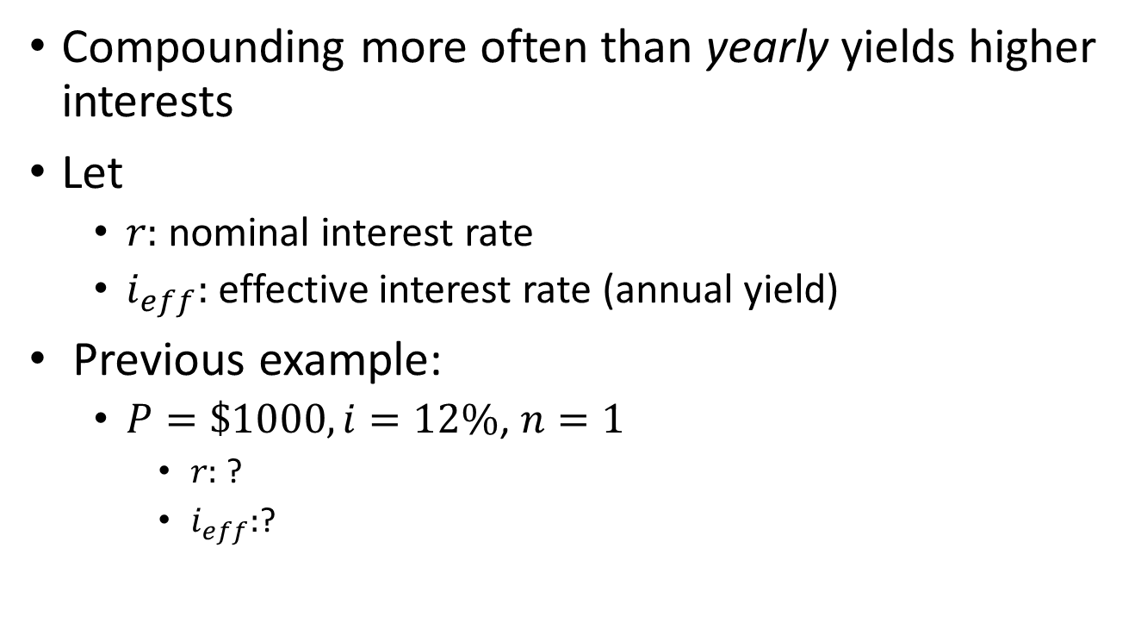
Effective interest rate
Compounding more often than yearly yields higher interests
Let
$r:$ nominal interest rate
$i_{eff}:$ effective interest rate (annual yield)
Previous example:
$P=\$1000, i=12\%$, $n=1$
$r:$ ?
$i_{eff}:$?

Slide 12
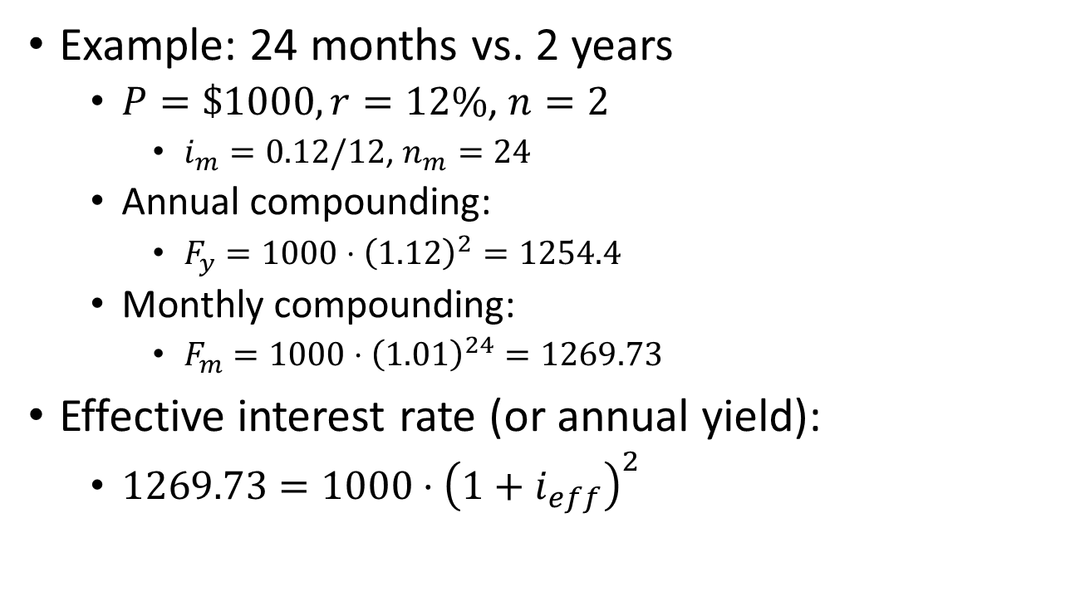
Effective interest rate:
Example: 24 months vs. 2 years
$P=\$1000, r=12\%$, $n=2$
$i_{m}=0.12/12$, $n_{m}=24$
Annual compounding:
$F_{y}=1000⋅{\left(1.12\right)}^{2}=1254.4$
Monthly compounding:
$F_{m}=1000⋅{\left(1.01\right)}^{24}=1269.73$
Effective interest rate (or annual yield):
$1269.73=1000⋅{\left(1+i_{eff}\right)}^{2}$

Slide 13
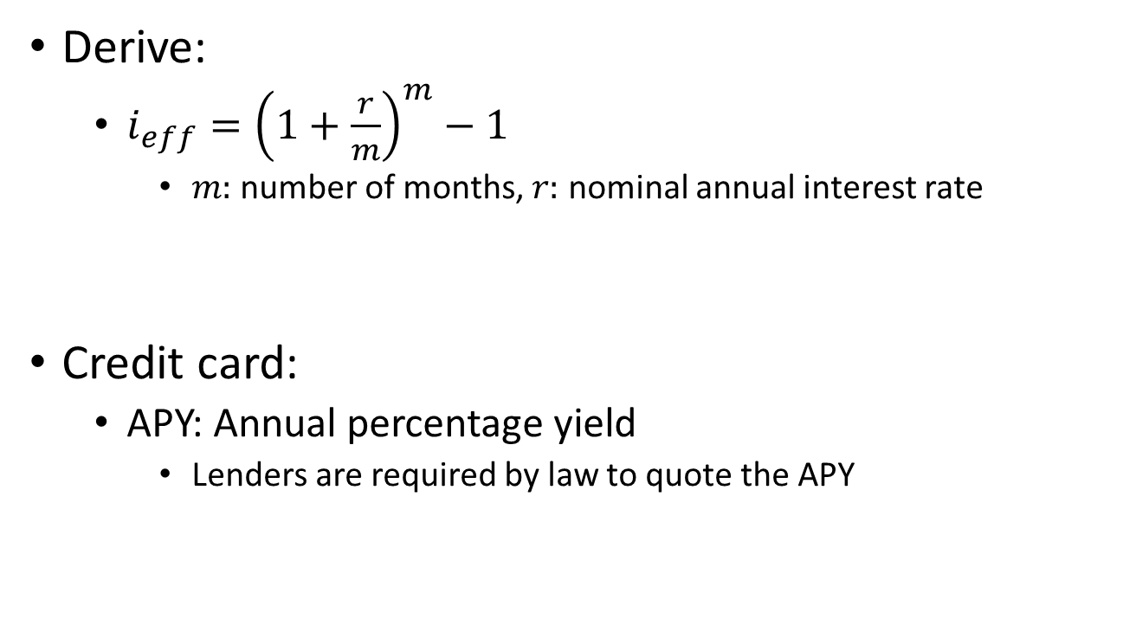
Effective interest rate:
Derive:
$i_{eff}={\left(1+\frac{r}{m}\right)}^{m}−1$
$m:$number of months, $r:$ nominal annual interest rate
Credit card:
APY: Annual percentage yield
Lenders are required by law to quote the APY

Slide 14
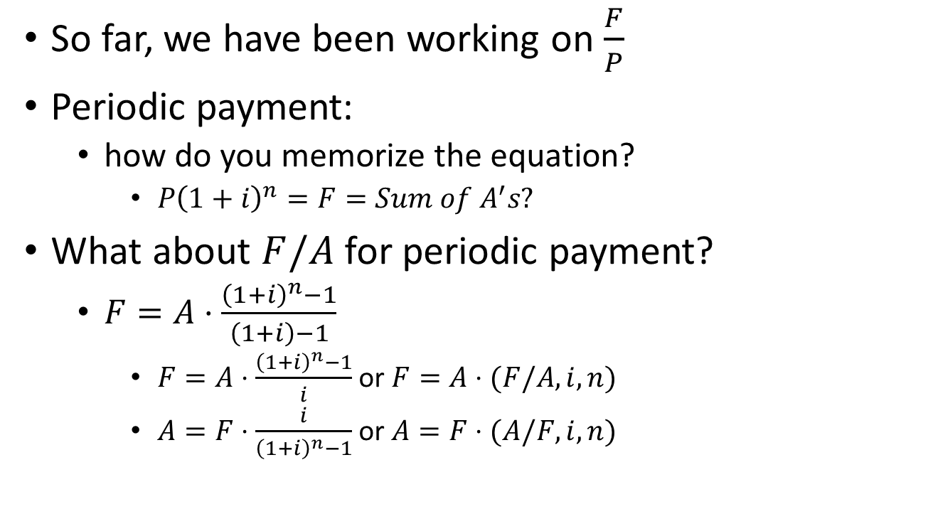
More on functional method & interest rate table:
So far, we have been working on $\frac{F}{P}$
Periodic payment:
how do you memorize the equation?
$P{\left(1+i\right)}^{n}=F=Sum of A^{′}s?$
What about $F/A$ for periodic payment?
$F=A⋅\frac{{\left(1+i\right)}^{n}−1}{\left(1+i\right)−1}$
$F=A⋅\frac{{\left(1+i\right)}^{n}−1}{i}$ or $F=A⋅(F/A,i,n)$
$A=F⋅\frac{i}{{\left(1+i\right)}^{n}−1}$ or $A=F⋅(A/F, i,n)$

Slide 15
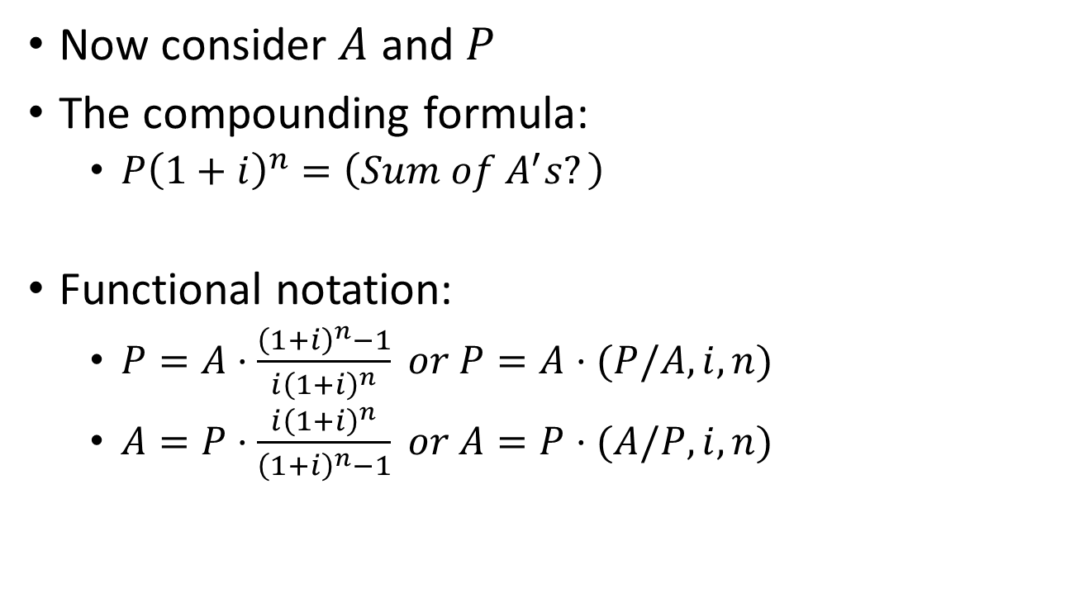
Functional notation for periodic payment
Now consider $A$ and $P$
The compounding formula:
$P{\left(1+i\right)}^{n}=\left(Sum of A^{′}s?\right)$
Functional notation:
$P=A⋅\frac{{\left(1+i\right)}^{n}−1}{i{\left(1+i\right)}^{n}} or P=A⋅(P/A,i,n)$
$A=P⋅\frac{i{\left(1+i\right)}^{n}}{{\left(1+i\right)}^{n}−1} or A=P⋅(A/P,i,n)$

Slide 16
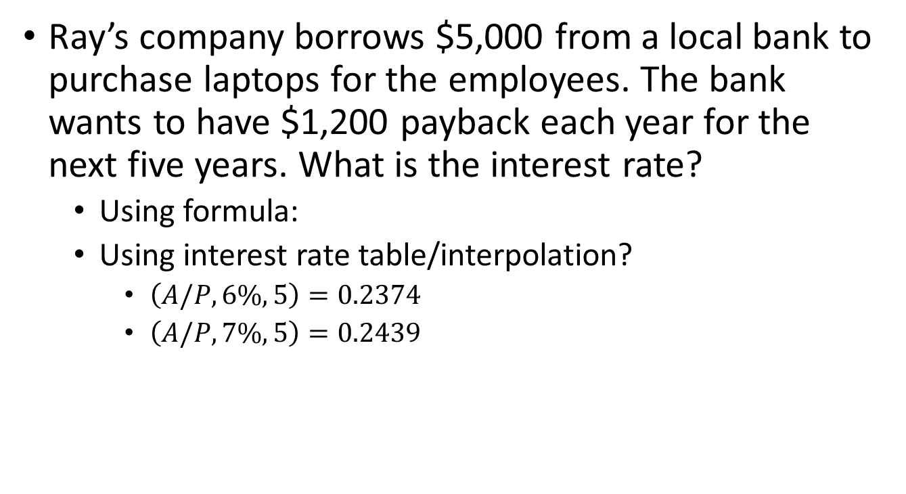
Example:
Ray’s company borrows $5,000 from a local bank to purchase laptops for the employees. The bank wants to have $1,200 payback each year for the next five years. What is the interest rate?
Using formula:
Using interest rate table/interpolation?
$\left(A/P,6\%,5\right)=0.2374$
$\left(A/P,7\%,5\right)=0.2439$

Slide 17
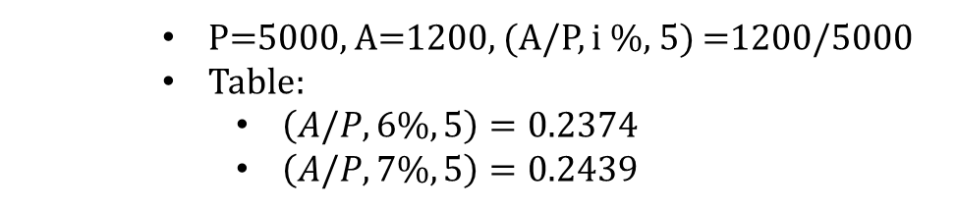
Interpolation:
P=5000, A=1200, (A/P, i %, 5) =1200/5000
Table:
$\left(A/P,6\%,5\right)=0.2374$
$\left(A/P,7\%,5\right)=0.2439$
Notes:
Answer: 6.4 %

Slide 18
Periodic payment: arithmetic series
Cases where cashflows increase/decrease with the time period
Constant amount increase/decrease
payment of $100, $120, $140, $160, …
Example:
Increasing maintenance costs, utility costs, insurance costs, etc.
0
1
2
3
4
n-1
n
A
A+(n-2)G
A+G
A+(n-1)G
A+2G
A+3G

Slide 19
How do you tackle this problem?
G: gradient

Slide 20
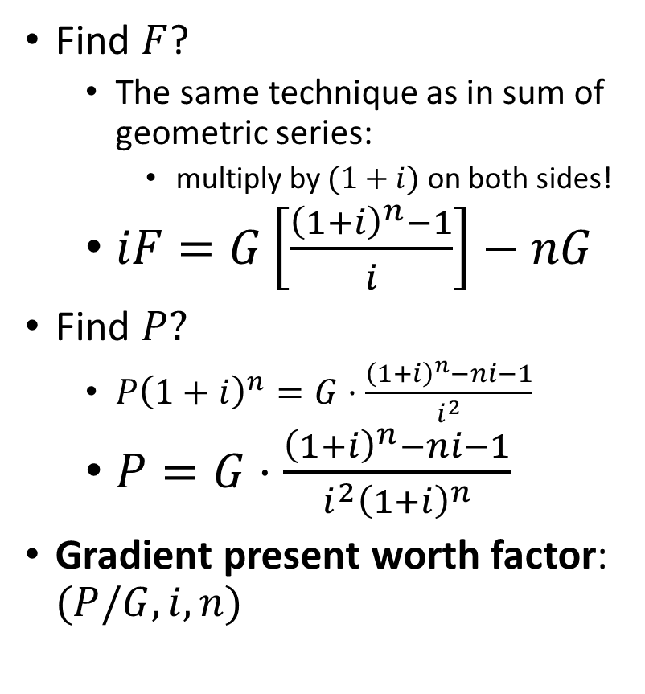
Relationship between G and P
Find $F$?
The same technique as in sum of geometric series:
multiply by $(1+i)$ on both sides!
$iF=G\left[\frac{{\left(1+i\right)}^{n}−1}{i}\right]−nG$
Find $P?$
$P{\left(1+i\right)}^{n}=G⋅\frac{{\left(1+i\right)}^{n}−ni−1}{i^{2}}$
$P=G⋅\frac{{\left(1+i\right)}^{n}−ni−1}{i^{2}{\left(1+i\right)}^{n}}$
Gradient present worth factor: $(P/G,i,n)$

Slide 21
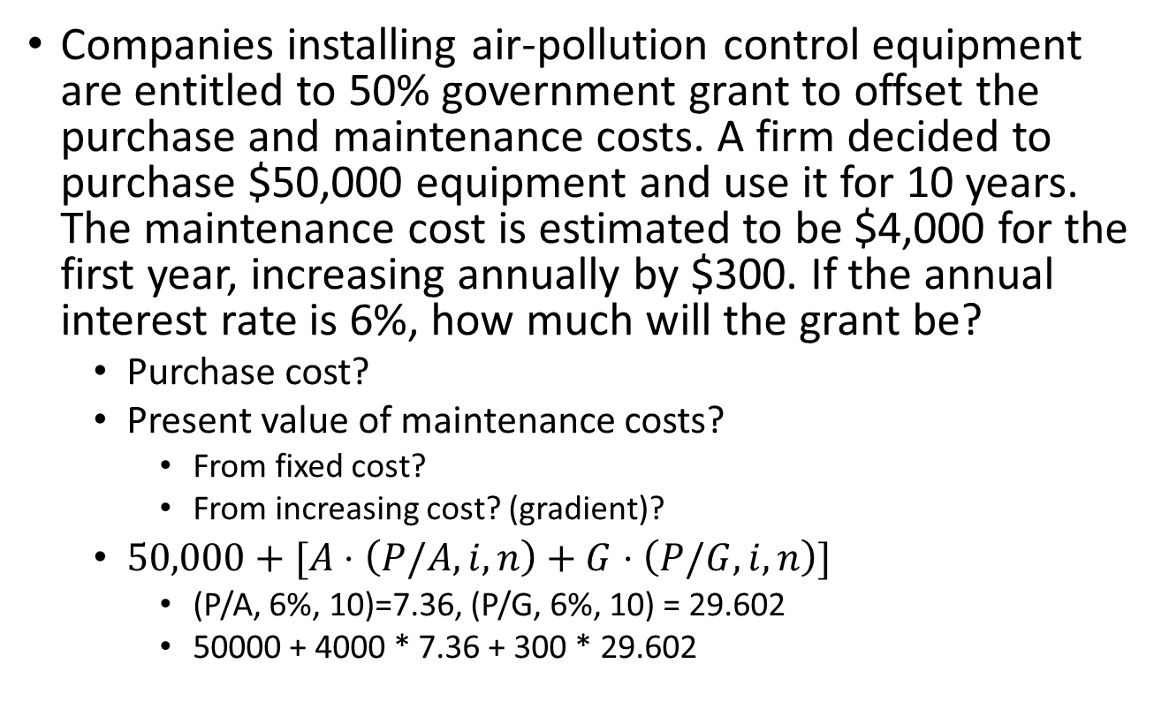
Example
Companies installing air-pollution control equipment are entitled to 50% government grant to offset the purchase and maintenance costs. A firm decided to purchase $50,000 equipment and use it for 10 years. The maintenance cost is estimated to be $4,000 for the first year, increasing annually by $300. If the annual interest rate is 6%, how much will the grant be?
Purchase cost?
Present value of maintenance costs?
From fixed cost?
From increasing cost? (gradient)?
$50,000+[A⋅\left(P/A,i,n\right)+G⋅\left(P/G,i,n\right)]$
(P/A, 6%, 10)=7.36, (P/G, 6%, 10) = 29.602
50000 + 4000 * 7.36 + 300 * 29.602
Notes:
88,321
44,160.50

Slide 22
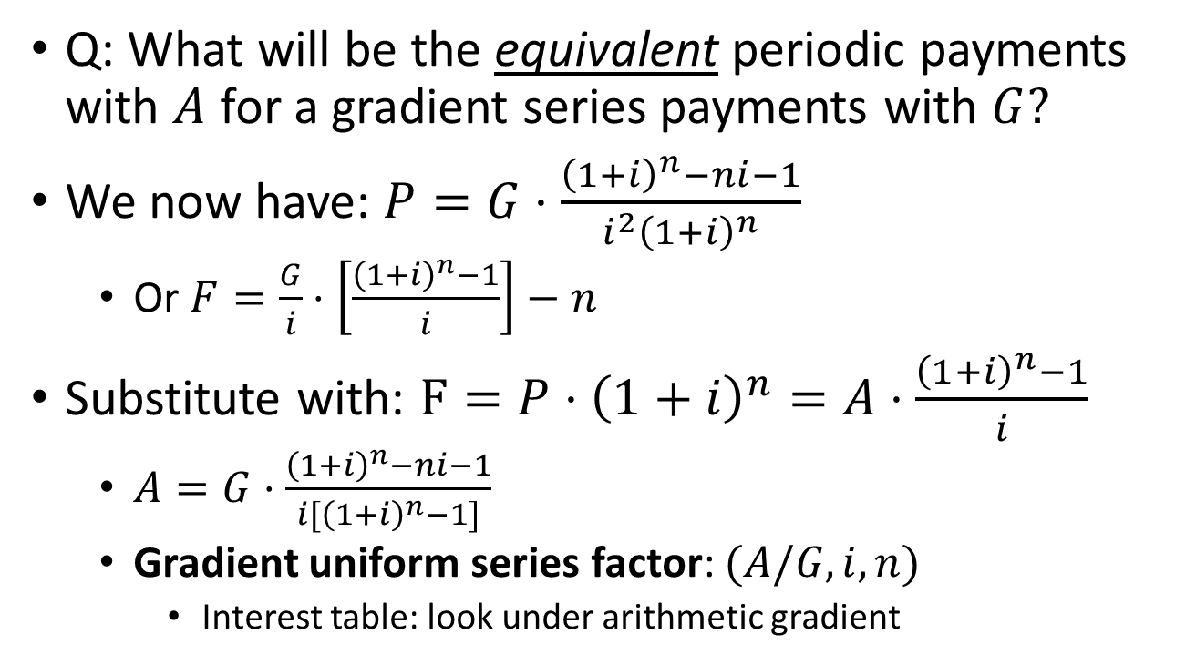
Conversion between A and G:
Q: What will be the equivalent periodic payments with $A$ for a gradient series payments with $G?$
We now have: $P=G⋅\frac{{\left(1+i\right)}^{n}−ni−1}{i^{2}{\left(1+i\right)}^{n}}$
Or $F=\frac{G}{i}⋅\left[\frac{{\left(1+i\right)}^{n}−1}{i}\right]−n$
Substitute with: $F=P⋅{\left(1+i\right)}^{n}=A⋅\frac{{\left(1+i\right)}^{n}−1}{i}$
$A=G⋅\frac{{\left(1+i\right)}^{n}−ni−1}{i[{\left(1+i\right)}^{n}−1]}$
Gradient uniform series factor: $(A/G,i,n)$
Interest table: look under arithmetic gradient

Slide 23
Cash flow diagram:
Arithmetic series with gradient $G$
Equal payment series with $A$

Slide 24
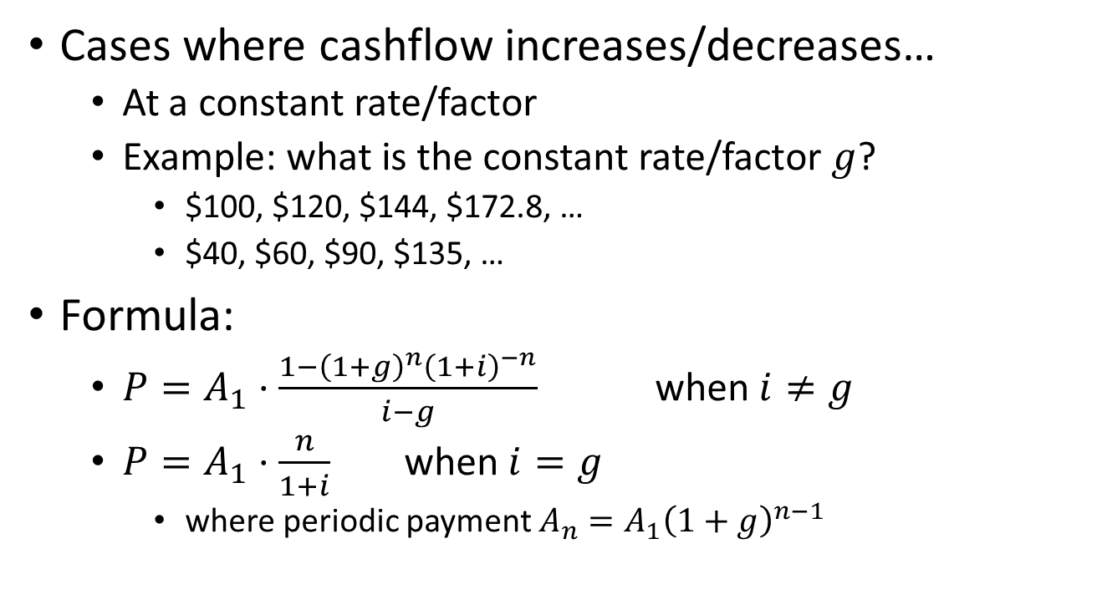
Geometric series
Cases where cashflow increases/decreases…
At a constant rate/factor
Example: what is the constant rate/factor $g$?
$100, $120, $144, $172.8, …
$40, $60, $90, $135, …
Formula:
$P=A_{1}⋅\frac{1−{\left(1+g\right)}^{n}{\left(1+i\right)}^{−n}}{i−g}$ when $i≠g$
$P=A_{1}⋅\frac{n}{1+i}$ when $i=g$
where periodic payment $A_{n}=A_{1}{\left(1+g\right)}^{n−1}$

Slide 25
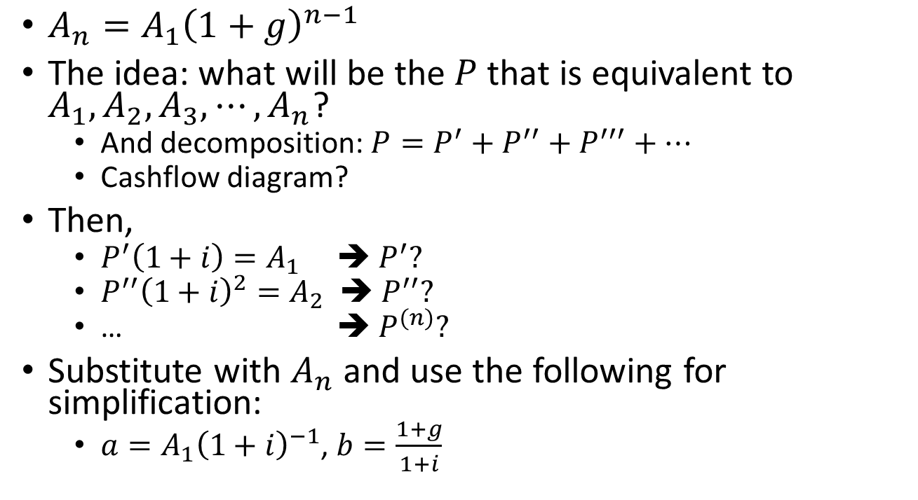

Derivation: $P$ and $A,g$
$A_{n}=A_{1}{\left(1+g\right)}^{n−1}$
The idea: what will be the $P$ that is equivalent to $A_{1},A_{2},A_{3},⋯, A_{n}$?
And decomposition: $P=P^{′}+P^{′′}+P^{′′′}+⋯$
Cashflow diagram?
Then,
$P^{′}\left(1+i\right)=A_{1}$ ➔ $P^{′}?$
$P^{′′}{\left(1+i\right)}^{2}=A_{2}$ ➔ $P^{′′}?$
… ➔ $P^{(n)}?$
Substitute with $A_{n}$ and use the following for simplification:
$a=A_{1}{\left(1+i\right)}^{−1}$, $b=\frac{1+g}{1+i}$

Slide 26
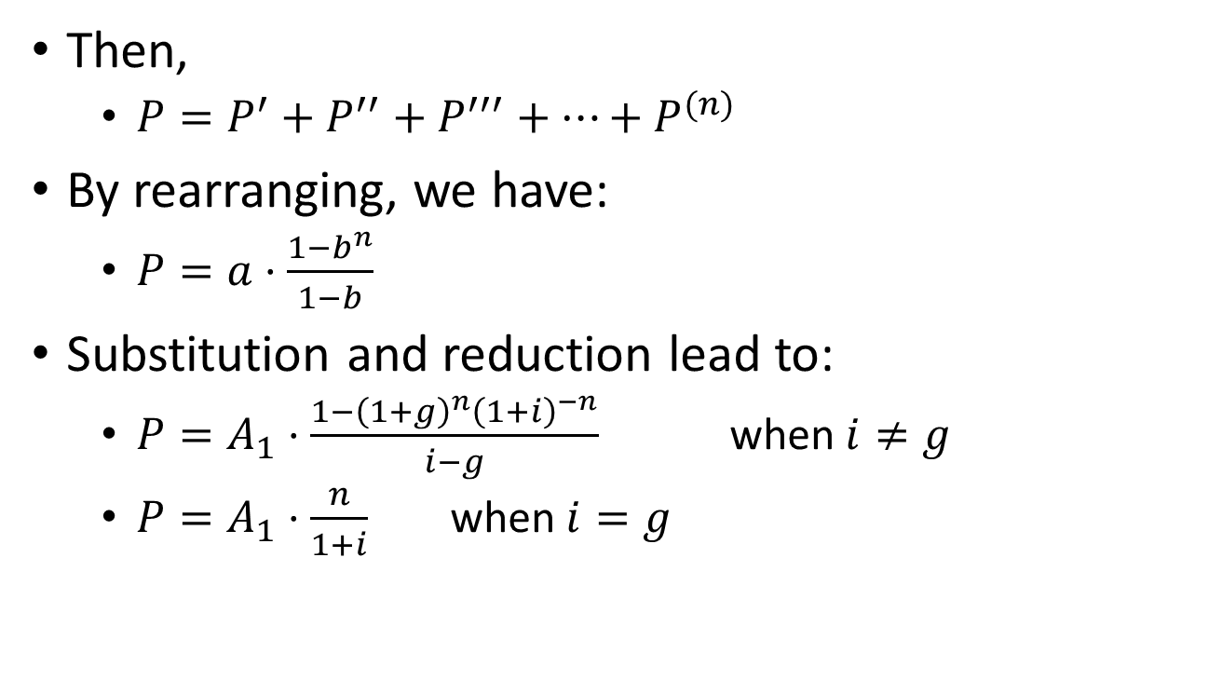
Derivation: $P$ and $A,g$
Then,
$P=P^{′}+P^{′′}+P^{′′′}+⋯+P^{(n)}$
By rearranging, we have:
$P=a⋅\frac{1−b^{n}}{1−b}$
Substitution and reduction lead to:
$P=A_{1}⋅\frac{1−{\left(1+g\right)}^{n}{\left(1+i\right)}^{−n}}{i−g}$ when $i≠g$
$P=A_{1}⋅\frac{n}{1+i}$ when $i=g$

Slide 27
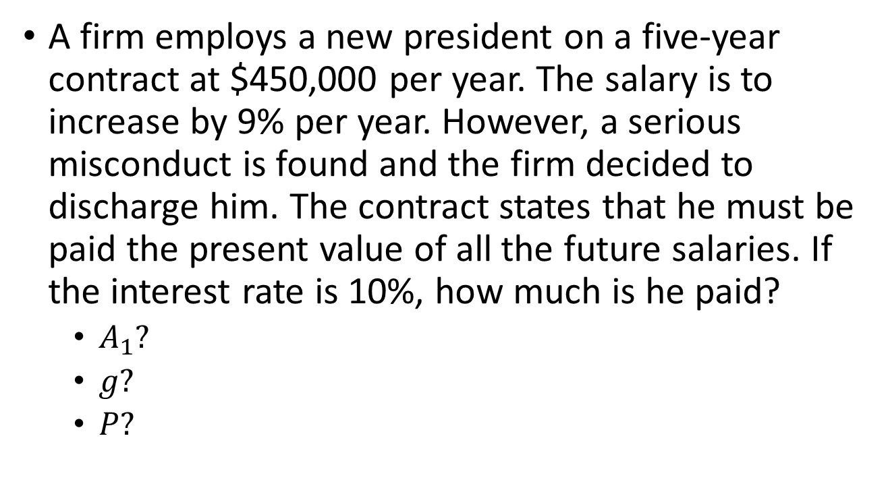
Example: geometric series payment
A firm employs a new president on a five-year contract at $450,000 per year. The salary is to increase by 9% per year. However, a serious misconduct is found and the firm decided to discharge him. The contract states that he must be paid the present value of all the future salaries. If the interest rate is 10%, how much is he paid?
$A_{1}?$
$g?$
$P?$
Notes:
A1 = 450,000
g = 0.09, i = 0.1
$2,008,601

Slide 28
Next class:
Irregular payments
Use cashflow diagram

