Slide 1
IET 333:
Week 4
Jung-woo Sohn (jzs177@psu.edu)
College of Information Sciences and Technology
The Pennsylvania State University

Slide 2
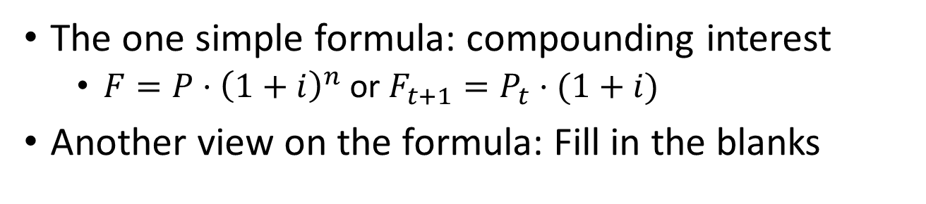
Cashflow:
What have we had so far?
The one simple formula: compounding interest
  $F=P⋅{\left(1+i\right)}^{n}$ or $F_{t+1}=P_{t}⋅(1+i)$
Another view on the formula: Fill in the blanks

Slide 3
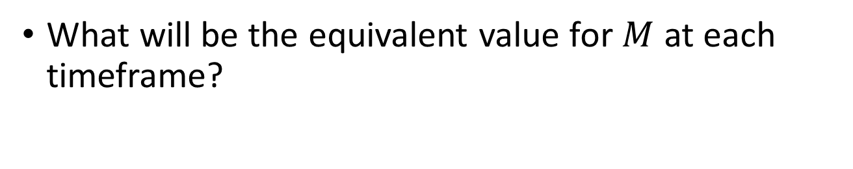
Exercise: Fill in the blank
What will be the equivalent value for $M$ at each timeframe?
Notes:
M/(1+i), M*(1+i), M*(1+i)^2

Slide 4
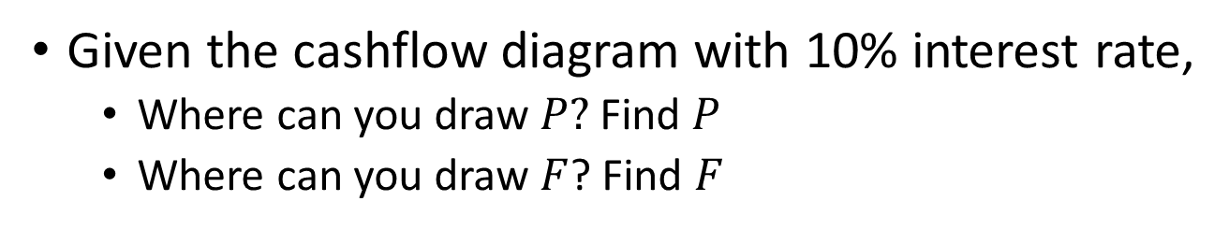
Irregular cashflow:
Present sum and future sum
Given the cashflow diagram with 10% interest rate,
  Where can you draw $P?$Find $P$
  Where can you draw $F$? Find $F$

Slide 5
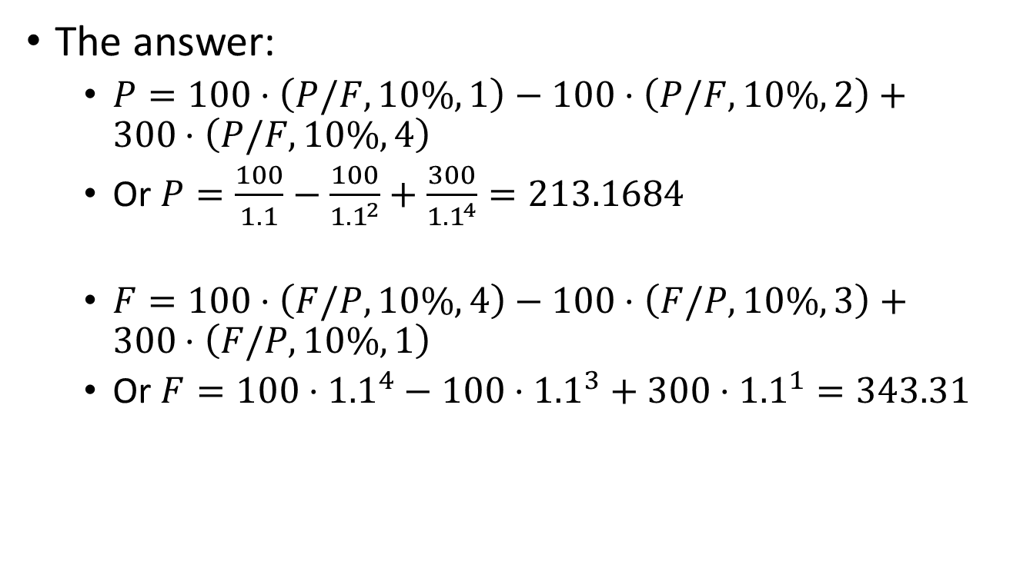
Irregular cashflow:
The answer:
  $P=100⋅\left(P/F, 10\%, 1\right)−100⋅\left(P/F,10\%,2\right)+300⋅\left(P/F, 10\%, 4\right)$
  Or $P=\frac{100}{1.1}−\frac{100}{{1.1}^{2}}+\frac{300}{{1.1}^{4}}=213.1684$
  $F=100⋅\left(F/P, 10\%, 4\right)−100⋅\left(F/P, 10\%, 3\right)+300⋅\left(F/P, 10\%, 1\right)$
  Or $F=100⋅{1.1}^{4}−100⋅{1.1}^{3}+300⋅{1.1}^{1}=343.31$

Slide 6
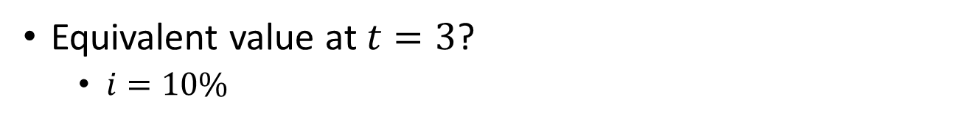
Equivalence calculation
Equivalent value at $t=3$?
  $i=10\%$
Notes:
100*1.1^3 + 80*1.1^2 + 120*1.1 + 200/1.1 + 100/(1.1^2)
100*(F/P, 10%, 3) + 80*(F/P, 10%, 2) + 120*(F/P, 10%, 1) + 200*(P/F, 10%, 1) + 100*(P/F, 10%, 2)
776.36 + 150 = 926.36

Slide 7
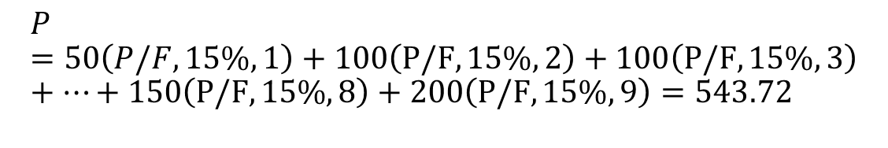

Composite cashflow: Brute force
Find the present sum $P$:
  $i=15\%$
$$P=50\left(P/F,15\%,1\right)+100\left(P/F,15\%,2\right)+100\left(P/F,15\%,3\right)+⋯+150\left(P/F,15\%,8\right)+200\left(P/F,15\%,9\right)=543.72$$

Slide 8

Composite cashflow: decomposition
Find the present sum $P$:
Notes:
43.48
198.54
244.85
56.58
Sum is 543.72 again

Slide 9
Composite cashflow: more on decomposition

Slide 10
Composite cashflow: more on decomposition

Slide 11
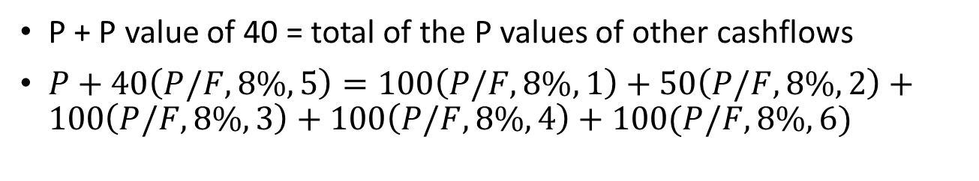
Composite cashflow: brute force
P + P value of 40 = total of the P values of other cashflows
$P+40\left(P/F,8\%,5\right)=100\left(P/F,8\%,1\right)+50\left(P/F,8\%,2\right)+100\left(P/F,8\%,3\right)+100\left(P/F,8\%,4\right)+100(P/F,8\%,6)$

Slide 12
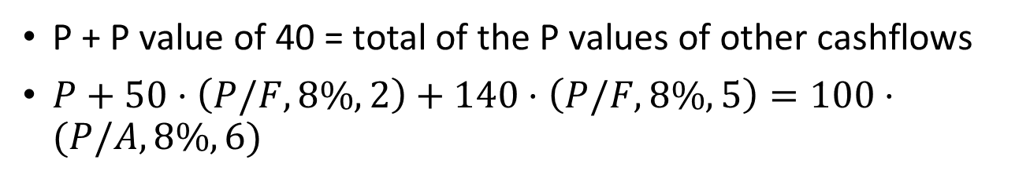
Composite cashflow: tailoring
P + P value of 40 = total of the P values of other cashflows
$P+50⋅\left(P/F,8\%,2\right)+140⋅\left(P/F,8\%,5\right)=100⋅(P/A,8\%,6)$

