Slide 1
IET 333 Week 5: Inflation rates Payback periods
Jung-woo Sohn (jzs177@psu.edu)
College of Information Sciences and Technology
Penn State University

Slide 2
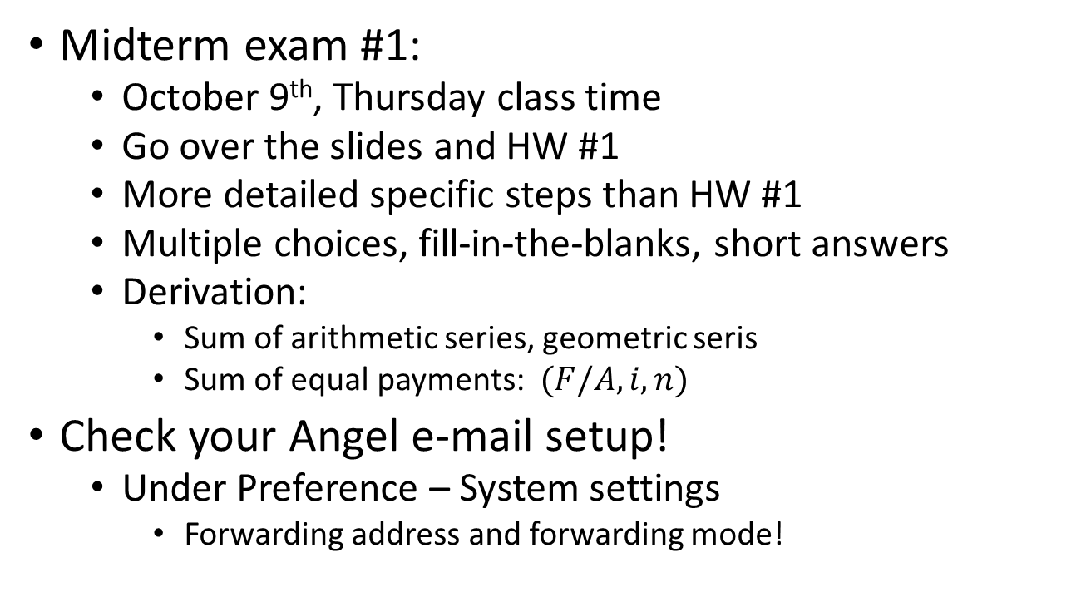
Announcements
Midterm exam #1:
October 9th, Thursday class time
Go over the slides and HW #1
More detailed specific steps than HW #1
Multiple choices, fill-in-the-blanks, short answers
Derivation:
Sum of arithmetic series, geometric seris
Sum of equal payments: $(F/A,i,n)$
Check your Angel e-mail setup!
Under Preference – System settings
Forwarding address and forwarding mode!

Slide 3
Feedback from the survey:
Students need:
Industry jobs
IET 333 as a required course
Course refinements:
More real-world examples
Then go back to abstract theories
More exercises
Pace of lectures: okay
Math skills required: okay
Clarity of slides: okay on average
Advanced track possible
Others:
L and R
Speak slowly!

Slide 4

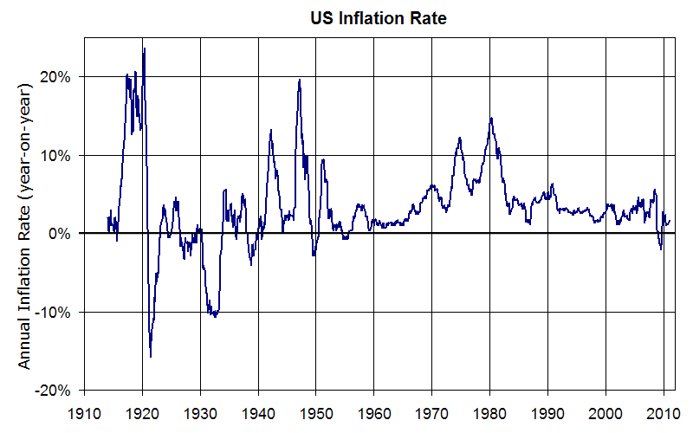

Inflation
What is inflation?
The same dollar buys less of an item over time
What is the effect?
Loss in the purchasing power over time

Slide 5
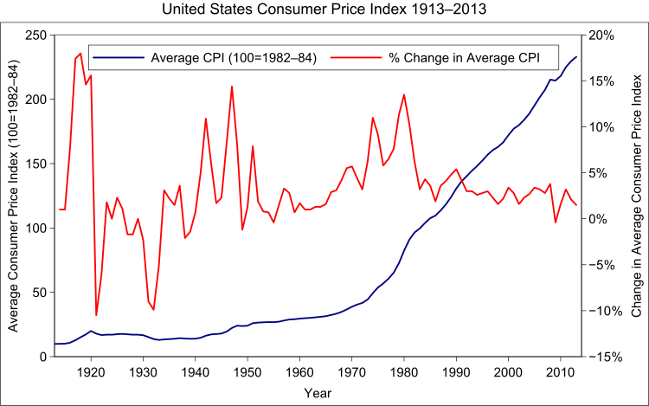

Consumer Price Index: CPI
How is inflation rate calculated?
The dollar amount of buying a basketful of goods…
Food, housing, apparel, transportation, medical care, etc.
CPI in US: based on 1982-84 dollar amount of $100
$\frac{CPI_{2}}{CPI_{1}}=\frac{Price_{2}}{Price_{1}}$
$CPI_{1}$ is often 100

Slide 6
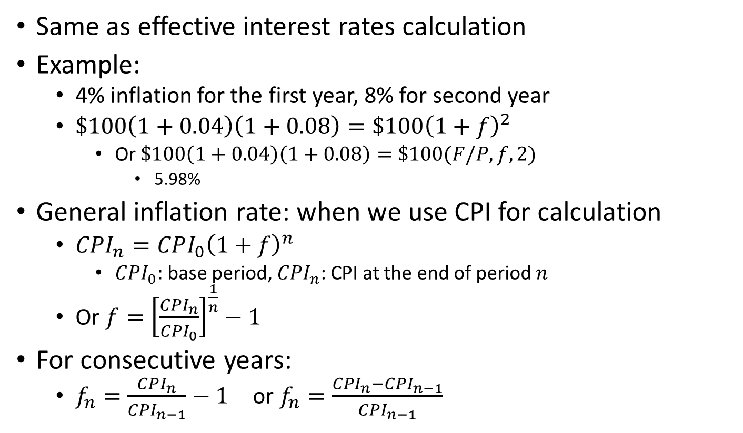
Average inflation rate
Same as effective interest rates calculation
Example:
4% inflation for the first year, 8% for second year
$\$100\left(1+0.04\right)\left(1+0.08\right)=\$100{\left(1+f\right)}^{2}$
Or $\$100\left(1+0.04\right)\left(1+0.08\right)=\$100(F/P,f,2)$
5.98%
General inflation rate: when we use CPI for calculation
$CPI_{n}=CPI_{0}{\left(1+f\right)}^{n}$
$CPI_{0}:$ base period, $CPI_{n}$: CPI at the end of period $n$
Or $f={\left[\frac{CPI_{n}}{CPI_{0}}\right]}^{\frac{1}{n}}−1$
For consecutive years:
$f_{n}=\frac{CPI_{n}}{CPI_{n−1}}−1$ or $f_{n}=\frac{CPI_{n}−CPI_{n−1}}{CPI_{n−1}}$

Slide 7
Equivalence calculations under inflation
Actual (current) dollar
Dollar amounts including the impact from inflation
Constant dollar (base-year dollar)
Value constant independent of the inflation
Dollar amounts at time period 0
So far, we assumed:

Slide 8
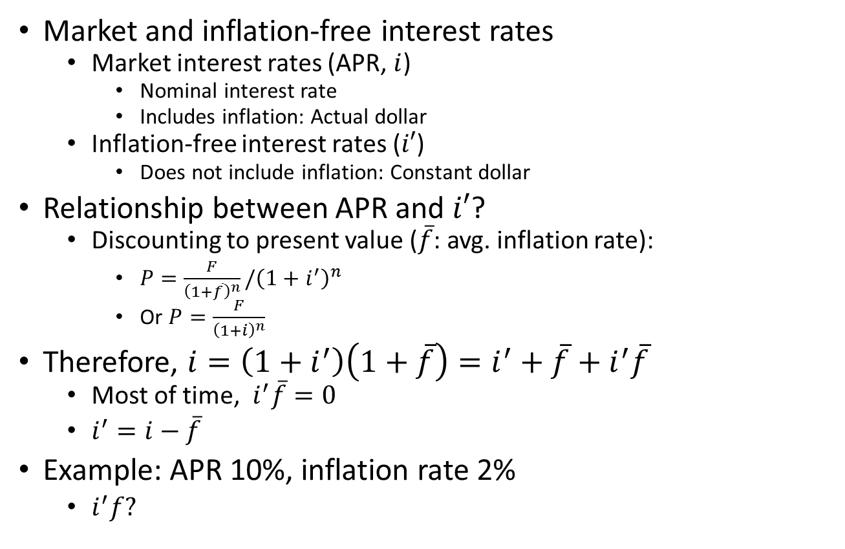
Equivalence calculations under inflation
Market and inflation-free interest rates
Market interest rates (APR, $i$)
Nominal interest rate
Includes inflation: Actual dollar
Inflation-free interest rates ($i′$)
Does not include inflation: Constant dollar
Relationship between APR and $i′$?
Discounting to present value ($\overline{f}$: avg. inflation rate):
$P=\frac{F}{{\left(1+\overline{f}\right)}^{n}}/{\left(1+i^{′}\right)}^{n}$
Or $P=\frac{F}{{\left(1+i\right)}^{n}}$
Therefore, $i={\left(1+i^{′}\right)\left(1+\overline{f}\right)=i}^{′}+\overline{f}+i^{′}\overline{f}$
Most of time, $i^{′}\overline{f}=0$
$i^{′}=i−\overline{f}$
Example: APR 10%, inflation rate 2%
$i^{′}f?$
Notes:
For example, APR 10%, inflation rate 2%, 10% * 2% = 0.2% which is negligible.

Slide 9
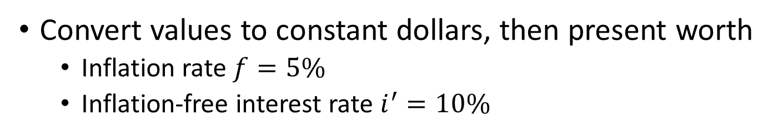
Equivalence calculations under inflation: Deflation method
Convert values to constant dollars, then present worth
Inflation rate $f=5\%$
Inflation-free interest rate $i^{′}=10\%$
Convert values to constant dollars, then present worth
n | Net cash flow in actual dollars
0 | -$75,000
1 | $32,000
2 | $35,700
3 | $32,800
4 | $29,000
5 | $58,000

Slide 10
Equivalence calculations under inflation: Deflation method
Actual
dollars
-$75,000 $32,000 $35,700 $32,800 $29,000 $58,000
Constant
dollars
-$75,000 $30,476 $32,381 $28,334 $23,853 $45,455
Present
worth
-$75,000 $27,706 $26,761 $21,288 $16,295 $28,218

Slide 11
Equivalence calculations under inflation: Deflation method
Actual
dollars
-$75,000 $32,000 $35,700 $32,800 $29,000 $58,000
Present
worth
-$75,000 $27,706 $26,761 $21,288 $16,295 $28,218

Slide 12
Payback periods:
Definition
Duration in which an investment pays for itself
“Break-even” point
Example: Constant cashflow
A tool changer purchased at $5,000
Generates $2,000 profit per year
2.5 years of payback periods

Slide 13
Payback periods:
Example: variable cashflows
A hydraulic machine is installed at a cost of $5,000. Its gross income and operating costs are given as in the table. What will be the payback period for this machine?
Year | Gross income | Operating cost
1 | $3,500 | $1,100
2 | $3,350 | $1,200
3 | $3,600 | $1,250
4 | $3,200 | $1,300
5 | $3,450 | $1,400
6 | $3,400 | $1,500
7 | $3,350 | $1,600

Slide 14

Payback periods:
Example: variable cashflows
Year | Gross income | Operating cost | Net income | Cumulative income
1 | $3,500 | $1,100 | $2,400 | $2,400
2 | $3,350 | $1,200 | $2,150 | $4,550
3 | $3,600 | $1,250 | $2,350 | $6,900
4 | $3,200 | $1,300
5 | $3,450 | $1,400
6 | $3,400 | $1,500
7 | $3,350 | $1,600
Payback period: $2+\frac{5000−4550}{2350}≃2.19$ years

Slide 15
Time-valued payback periods
A hydraulic machine example: (annual interest 10%)
Year | Cashflow in present worth
0 | -$5,000
1 | $2,000
2 | $1,818
3 | $1,653
4 | …
5 | …
6 | …
Year | Cashflow
0 | -$5,000
1 | $2,200
2 | $2,200
3 | $2,200
… | $2,200
… | $2,200
… | $2,200
Payback period = 2 + 1182/1653 = 2.71 years

Slide 16
Payback periods and decision-makings
Alternative projects
Merits and limitations of payback periods
Pros:
Simpler to use
Suitable for small investments
Quicker investment decision
Projects involving rapidly changing technologies
Easily understood
Cons:
Time value of money ignored
An approximate, less exact method

Slide 17
More on decision-makings: microeconomics
Diminishing marginal returns:
Consume preference and utility functions

