Slide 1
Future Worth and Annual Worth
Jung-woo Sohn (jzs177@psu.edu)

Slide 2
Future worth (FW)
Decision-makings in the future
Value analysis
Need for conversion of money values into the future
Again, this is about comparison!
Definition
The future value of all the cashflows pertaining to the project

Slide 3
Future worth: What is it good for?
Decision-makings in the future
Financial decision-makings rather than engineering (or project-based) decision-makings
Example:
Retirement planning:
Savings of $10,000 needed after 5 years
Financial planning:
Firm A needs a capital pool of $1,000,000 after 10 years
Simply, FW is the dollar amounts in the future

Slide 4

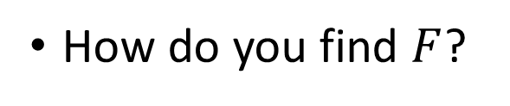
Future worth and the equivalence analysis
Finding the future value (or future sum) $F$ from a cashflow diagram/table
How do you find $F$?

Slide 5


Future worth and the equivalence analysis
Benefit and cost analysis
Benefit: ${FW}_{benefits}$
Costs: ${FW}_{costs}$
Future worth (net benefit):

Slide 6




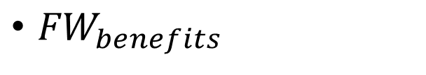

In-class exercise: Finding $FW$?
Assume annual interest rate of 6%
${FW}_{benefits}$
252 + 119 + 636
${FW}_{costs}$
669 + 281 + 300
Future worth $FW$(net benefit):
$FW$ $=1007−1250= −243$
Note: $PW$ $= 753−934 = −181$

Slide 7
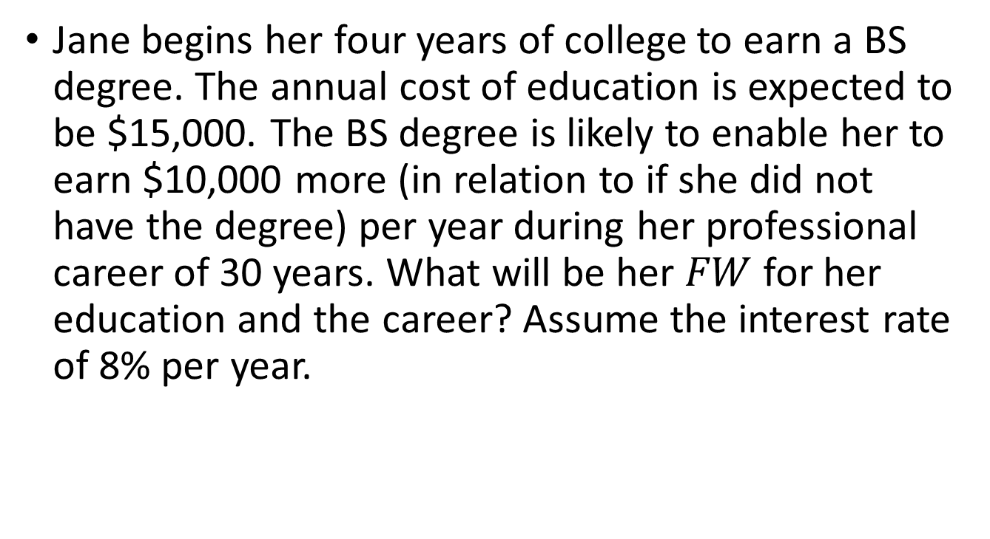
Example: college education
Jane begins her four years of college to earn a BS degree. The annual cost of education is expected to be $15,000. The BS degree is likely to enable her to earn $10,000 more (in relation to if she did not have the degree) per year during her professional career of 30 years. What will be her $FW$ for her education and the career? Assume the interest rate of 8% per year.

Slide 8
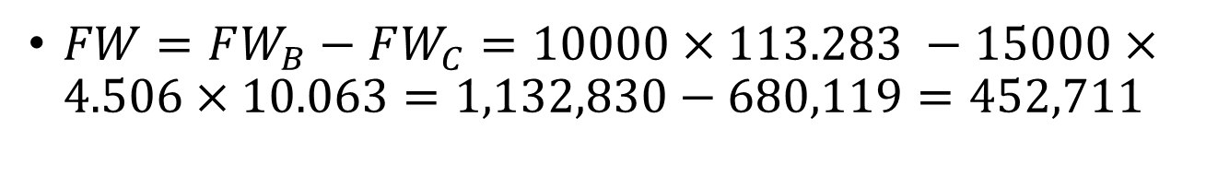

Example: college education
$FW_{B}=10000⋅\left(F/A,8\%,30\right)$
$FW_{C}=15000⋅\left(F/A,8\%,4\right)⋅\left(F/P,8\%,30\right)$
Or $FW_{C}=15000⋅\left(P/A,8\%,4\right)⋅(F/P,8\%,34)$
$FW=FW_{B}−FW_{C}=10000×113.283 −15000×4.506×10.063=1,132,830−680,119=452,711$

Slide 9
Future worth: when to use
Note that PW analysis and FW analysis are equivalent
When does FW analysis become useful, then?
When future is important
Dollar amount written in terms of the future
Pay attention to the “time” for decision-makings
Mostly financial planning cases
Building a retirement equity, for example
PW analysis is more frequently used
Nature of future: involves uncertainty
Comparisons of mutually exclusive projects
The best choice will be the same whether PW or FW analysis

Slide 10
Annual worth (AW):
Annual Equivalence (AE)
Meaning of AW:
The equivalence net cash inflow each year over the useful life
Why AW analysis?
Benefits/costs per year (or per unit period)
Example) $10,000 value right now vs. $1,200 value per year over 10 years
Good for planning
Most organizations operate with annual plans
Example) Based on the annual revenue of $10,000, $1,300 can be allocated annually for the project investment

Slide 11



Annual worth: simple examples
$$A=P⋅(A/P,i,n)$$
$$A=F⋅(A/F,i,n)$$
$$A=???$$

Slide 12
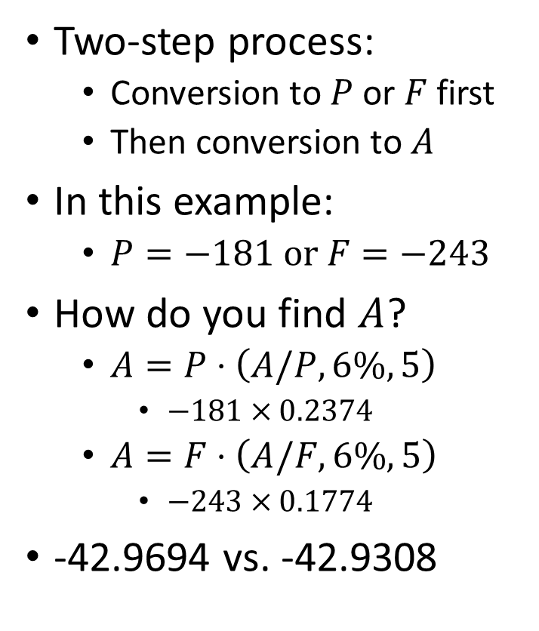
Annual worth and the equivalence analysis
annual interest rate of 6%
Two-step process:
Conversion to $P$ or $F$ first
Then conversion to $A$
In this example:
$P=−181 or F=−243$
How do you find $A$?
$A=P⋅\left(A/P,6\%,5\right)$
$−181×0.2374$
$A=F⋅\left(A/F,6\%,5\right)$
$−243×0.1774$
-42.9694 vs. -42.9308

Slide 13
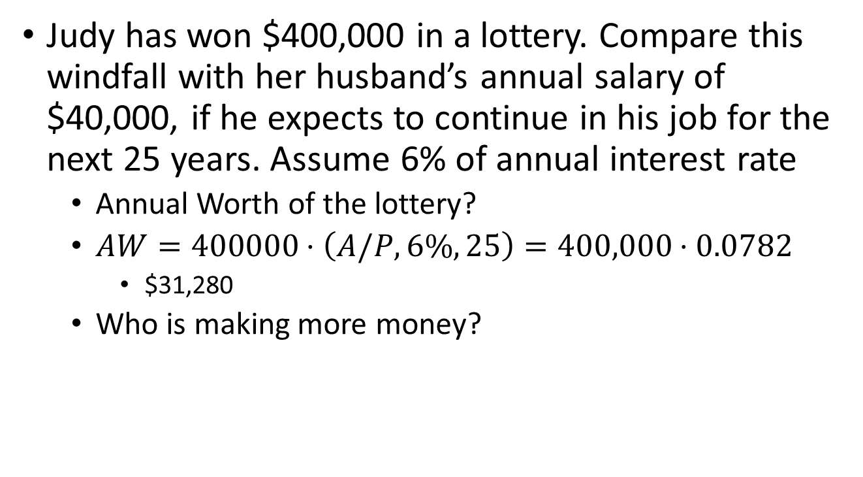
Example: lotto vs. salary
Judy has won $400,000 in a lottery. Compare this windfall with her husband’s annual salary of $40,000, if he expects to continue in his job for the next 25 years. Assume 6% of annual interest rate
Annual Worth of the lottery?
$AW=400000⋅\left(A/P,6\%,25\right)=400,000⋅0.0782$
$31,280
Who is making more money?

Slide 14
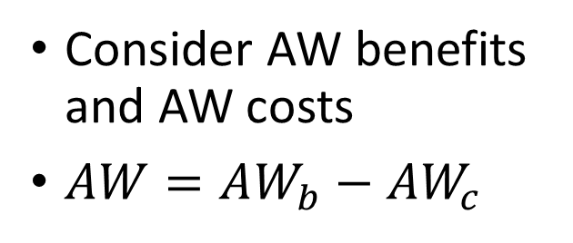
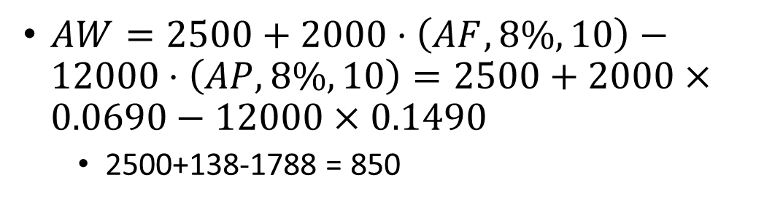
Example: AW benefit and AW cost
Determine the annual worth of a 10-year project whose first cost is $12,000, annual benefit is $2,500, and salvage value is $2,000. Assume an annual interest of 8% per year
Consider AW benefits and AW costs
$AW=AW_{b}−AW_{c}$
$AW=2500+2000⋅\left(AF,8\%,10\right)−12000⋅\left(AP,8\%,10\right)=2500+2000×0.0690−12000×0.1490$
2500+138-1788 = 850

Slide 15
Example: Purchasing a car revisited
Harry is buying a new car. He is considering Honda Accord, Chevy Prizm, and Plymouth Acclaim, each with a seven-year useful life. Given the following data, which one should he buy if the decision criterion is annual worth? Assume an annually compounded interest rate of 9% per year.
Car | First Cost | Annual Cost | Salvage Value
Honda Accord | $20,000 | $300 | $3,000
Chevy Prizm | $18,000 | $500 | $2,000
Plymouth acclaim | $17,500 | $750 | $1,500

Slide 16
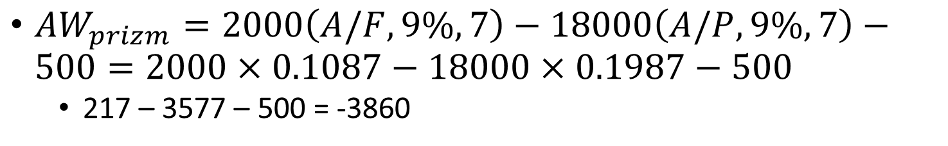
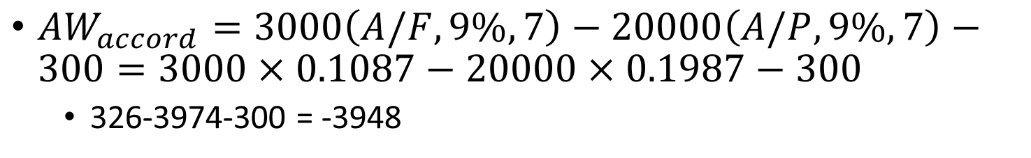
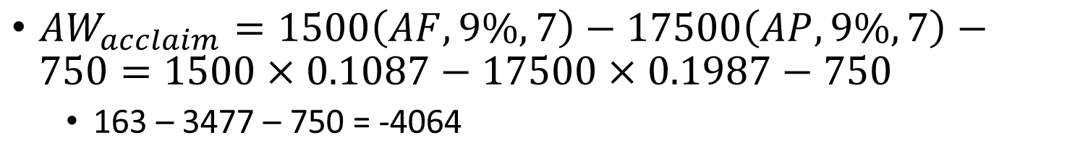
Example: Purchasing a car revisited
$AW_{accord}=3000\left(A/F,9\%,7\right)−20000\left(A/P,9\%,7\right)−300=3000×0.1087−20000×0.1987−300$
326-3974-300 = -3948
$AW_{prizm}=2000\left(A/F,9\%,7\right)−18000\left(A/P,9\%,7\right)−500=2000×0.1087−18000×0.1987−500$
217 – 3577 – 500 = -3860
$AW_{acclaim}=1500\left(AF,9\%,7\right)−17500\left(AP,9\%,7\right)−750=1500×0.1087−17500×0.1987−750$
163 – 3477 – 750 = -4064

Slide 17
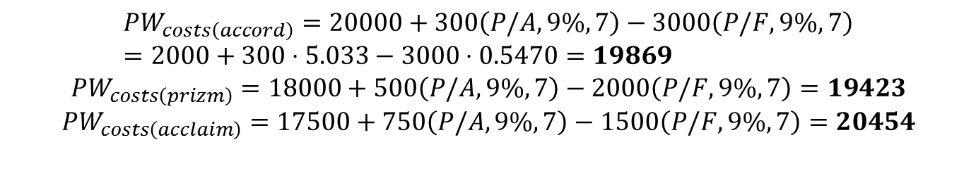
Example: purchasing a car revisited
$$PW_{costs\left(accord\right)}=20000+300\left(P/A,9\%,7\right)−3000\left(P/F,9\%,7\right)=2000+300⋅5.033−3000⋅0.5470=19869$$
$$PW_{costs\left(prizm\right)}=18000+500\left(P/A,9\%,7\right)−2000\left(P/F,9\%,7\right)=19423$$
$$PW_{costs\left(acclaim\right)}=17500+750\left(P/A,9\%,7\right)−1500\left(P/F,9\%,7\right)=20454$$

Slide 18
Annual Worth and analysis period
Does AW analysis needs equal analysis periods between projects?
No
AW is already converted to *annual* cashflow
No need for LCM-based analysis period calibration

Slide 19
Annual Worth and analysis period
Which choice will be the best option in terms of AW analysis? Assume yearly interest rate of 9%.
Choice | Fist cost | Annual operating cost | Useful life in years | Salvage value
Machine A | $3,000 | $200 | 2 | $250
Machine B | 8,000 | 100 | 4 | 500
Machine C | 5,000 | 150 | 3 | 300

Slide 20
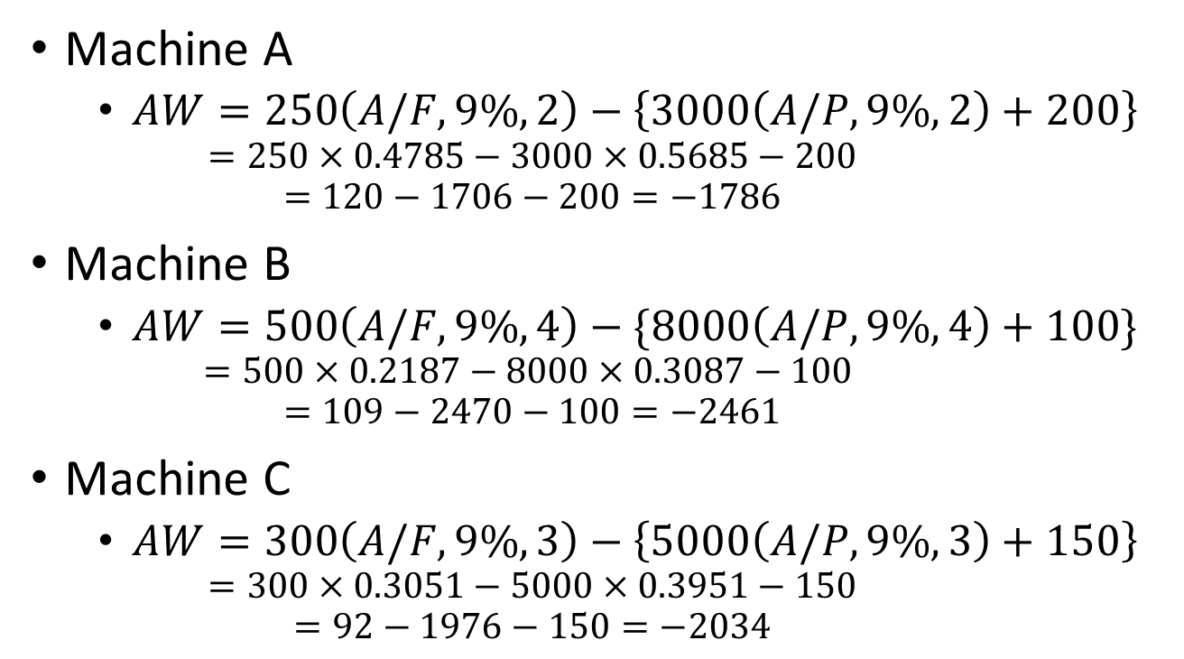
Annual worth and analysis period
Machine A
$AW=250\left(A/F,9\%,2\right)−\left\{3000\left(A/P,9\%,2\right)+200\right\}$
$$=250×0.4785−3000×0.5685−200$$
$$=120−1706−200=−1786$$
Machine B
$AW=500\left(A/F,9\%,4\right)−\{8000\left(A/P,9\%,4\right)+100\}$
$$=500×0.2187−8000×0.3087−100$$
$$=109−2470−100=−2461$$
Machine C
$AW=300\left(A/F,9\%,3\right)−\left\{5000\left(A/P,9\%,3\right)+150\right\}$
$$=300×0.3051−5000×0.3951−150$$
$$=92−1976−150=−2034$$

Slide 21

Unequal lives: PW analysis
PW analysis results: Over 12 years
$PW_{A}=−12788$
$PW_{B}=−17615$
$PW_{C}=−14563$

