Slide 1
Present worth and future worth
Jung-woo Sohn (jzs177@psu.edu)

Slide 2
Announcements
Homework 2-1: Due today (Oct. 28th)
In case you need to rework on question 2, feel free to submit on the next class (Thursday, October 30th)
Homework assignment 2-2: Due next Thursday (Nov. 6th)
Please do not miss the classes:
Missing multiple classes is a bad idea!
High correlation with # of classes missed and the final letter grade
In case you had to miss a class, be sure to go over the slides

Slide 3
Present worth
Decision-making right now
Need for conversion of values back to present
Making comparisons
Usually for decisions related engineering projects
Which project will be the best?
Will investing on this project eventually payoff?

Slide 4


Projects and decision-makings
A small local office:
10 Dell PCs or 10 Macs? Or a savings account?
What kind of things to consider?
Revenue generated from the employee productivity increase
Purchase price
Maintenance cost
Software?
Parts upgrade?
Training cost for employees
etc.
Savage value
Benefit/cost analysis over a project lifetime period

Slide 5
Present worth
Definition:
The present value of all the cashflows pertaining to the project
Assumptions:
An alternative opportunity of earning interest:
Ex) Making a deposit in a savings account
Minimum Attractive Rate of Return (MARR)
The interest rate a firm (or you) can always invest in.
Usually set by the top managers
Can be simply market interest rates
Always consider a virtual savings account…
That earns MARR all the time!

Slide 6


Present worth and equivalence analysis
Finding the present value (or principal) $P$ from a cashflow diagram/table
How do you find $P ?$

Slide 7


Present worth and equivalence analysis
Often handy to distinguish benefits from costs
Benefit: $PW_{benefits}$
Costs: $PW_{costs}$
Present worth (net benefit):

Slide 8




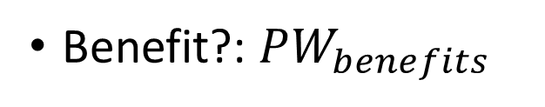

In-class exercise: Finding $PW$?
Assume annual interest rate of 6%
Benefit?: $PW_{benefits}$
$$189+89+475$$
Costs?: $PW_{costs}$
$$500+210+224$$
Present worth (net benefit)?:
$PW$ $= 753−934 = −181$

Slide 9
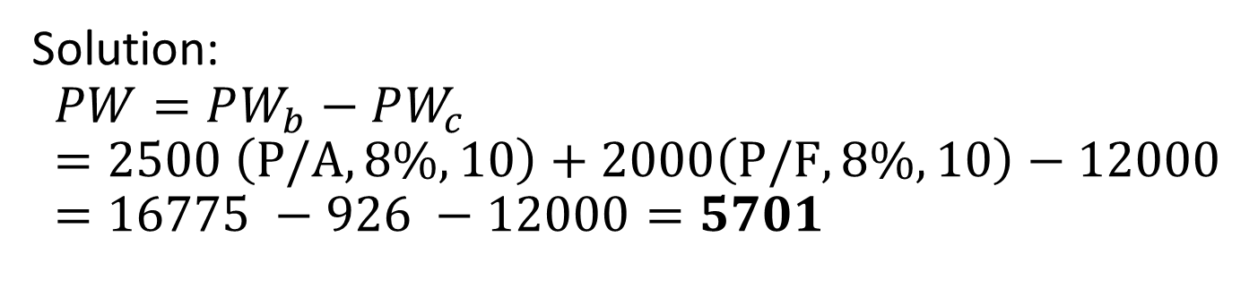
Example: purchasing an equipment
Determine the present worth of a 10-year project whose first cost is $12,000, net annual benefit is $2,500, and the final salvage value is $2,000. Assume an annually compounded interest rate of 8% per year
Draw cashflow diagram
Find the present worth
Solution:
$$PW=PW_{b}−PW_{c}=2500 \left(P/A, 8\%, 10\right)+2000\left(P/F, 8\%, 10\right)−12000=16775 −926 −12000=5701$$

Slide 10
A typical pattern: present worth analysis of a project
Initial purchase cost
Periodic benefits or maintenance costs
Final salvage value

Slide 11
Research project example
Modern Manufacturer is considering the following projects as the next year’s R&D efforts. On the basis of present worth, which project will be selected for funding? (Assume the annual interest rate of 12%) All the projects will (i) take two years to develop and earn income during the five years beyond development
Project | Annual Cost (during development) | Annual Income (during profitability)
A | $2000 | $3500
B | $3500 | $4800

Slide 12
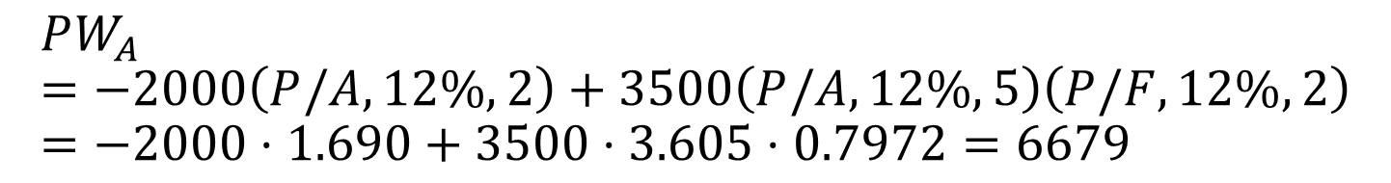
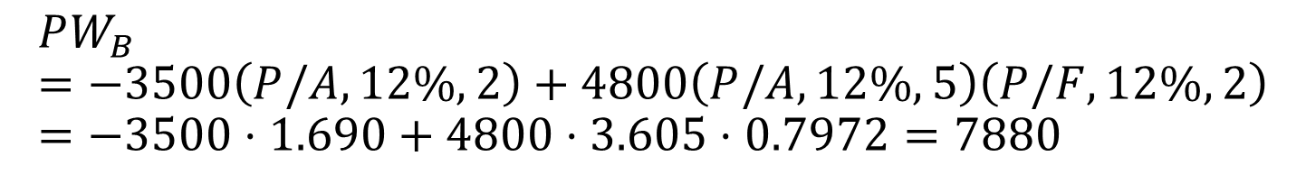
Research project example
$$PW_{A}=−2000\left(P/A,12\%,2\right)+3500\left(P/A,12\%,5\right)\left(P/F,12\%,2\right)=−2000⋅1.690+3500⋅3.605⋅0.7972=6679$$
$$PW_{B}=−3500\left(P/A,12\%,2\right)+4800\left(P/A,12\%,5\right)\left(P/F,12\%,2\right)=−3500⋅1.690+4800⋅3.605⋅0.7972=7880$$

Slide 13
Example: Purchasing a car
Harry is buying a new car. He is considering Honda Accord, Chevy Prizm, and Plymouth Acclaim, each with a seven-year useful life. Given the following data, which one should he buy if the decision criterion is present worth? Assume an annually compounded interest rate of 9% per year.
Car | First Cost | Annual Cost | Salvage Value
Honda Accord | $20,000 | $300 | $3,000
Chevy Prizm | $18,000 | $500 | $2,000
Plymouth acclaim | $17,500 | $750 | $1,500

Slide 14
Example: Purchasing a car
Things to consider:
What will be the benefit for this case?
Solution:
$PW_{costs\left(accord\right)}=20000+300\left(P/A,9\%,7\right)−3000\left(P/F,9\%,7\right)=2000+300⋅5.033−3000⋅0.5470=19869$
$PW_{costs\left(prizm\right)}=18000+500\left(P/A,9\%,7\right)−2000\left(P/F,9\%,7\right)=19423$
$PW_{costs\left(acclaim\right)}=17500+750\left(P/A,9\%,7\right)−1500\left(P/F,9\%,7\right)=20454$

Slide 15
Investment exercise: running a business
Mutually exclusive (or perfect substitution) assumed between choices
Example) Nina decides to venture into business. The business possibilities are as follows. Assuming annual interest rate of 12% and the total time periods of 25 years, which business will be the best for Nina based on the PW criteria?
Business type | Initial investment | Net Annual Income | Terminal Value
Farmer’s market | $120,000 | $18,000 | $45,000
Gas Station | $240,000 | $36,000 | $60,000
Grocery Store | $140,000 | $25,000 | $48,500
Notes:
PW_F = - 120,000 + 18000(P/A, 12%, 25) + 45000(P/F, 12%, 25)

Slide 16
Unequal lives
How to make a comparison for an engineering project?
Machine A: 3 years of lifespan
Machine B: 5 years of lifespan
Need for make the project period the same!
Use of Least Common Multiple (LCM)
In this case, 15 years which is the LCM of 3 and 5
Compare machine A and B for a time span of 15 years
Implicit assumptions:
The suppliers will continue to in business
They can offer alternatives at the same price
Benefits will remain unchanged throughout the analysis period

Slide 17
Unequal lives: example
Which choice will be the best option in terms of PW analysis? Assume yearly interest rate of 9%.
Choice | First cost | Annual operating cost | Useful life in years | Salvage value
Machine A | $3,000 | $200 | 2 | $250
Machine B | 8,000 | 100 | 4 | 500
Machine C | 5,000 | 150 | 3 | 300
To consider:
What will be the project years for the comparison?
Within this time period, what will be the PW of each option?

Slide 18



Unequal lives: example
Having the “same” period for each machine options:
Machine A
Machine B
Machine C

Slide 19
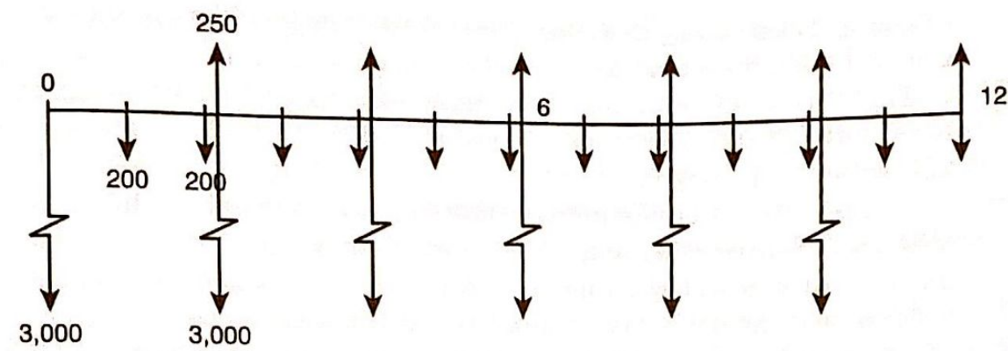
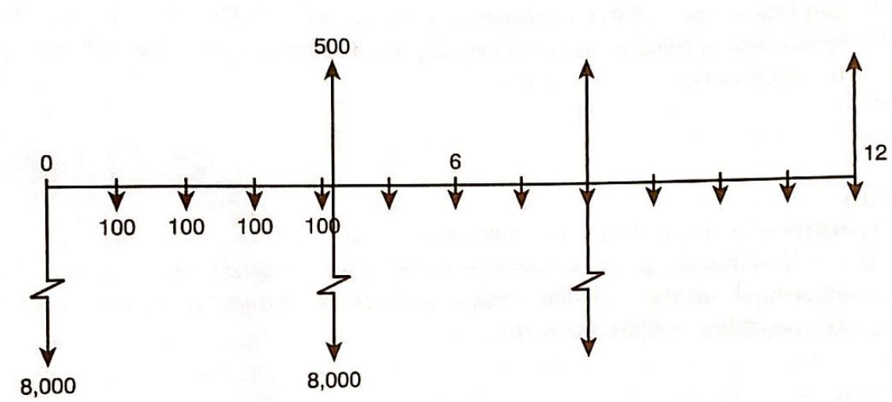
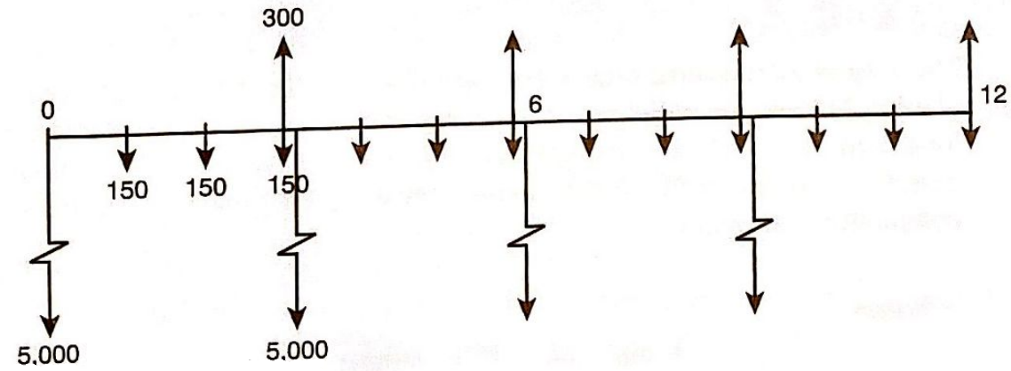
Machine A
Machine B
Machine C

Slide 20
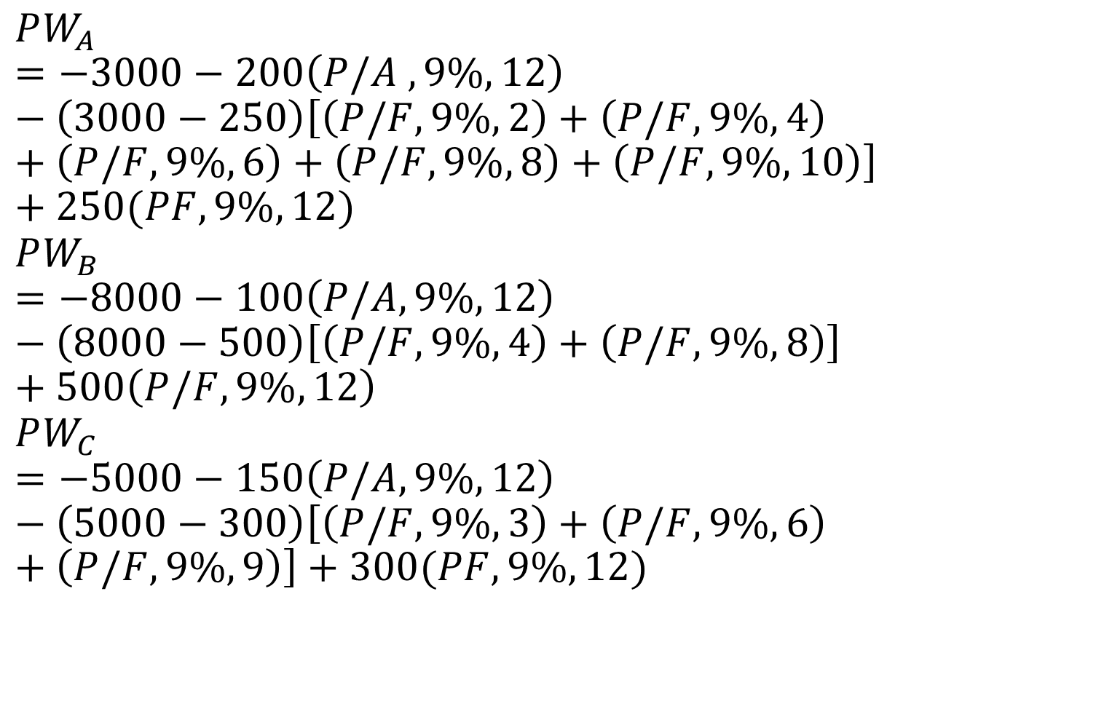
Unequal lives: example
$$PW_{A}=−3000−200\left(P/A ,9\%, 12\right)−\left(3000−250\right)\left[\left(P/F, 9\%, 2\right)+\left(P/F,9\%,4\right)+\left(P/F,9\%,6\right)+\left(P/F,9\%,8\right)+\left(P/F,9\%,10\right)\right]+250(PF,9\%,12)$$
$$PW_{B}=−8000−100\left(P/A,9\%,12\right)−\left(8000−500\right)\left[\left(P/F,9\%,4\right)+\left(P/F,9\%,8\right)\right]+500\left(P/F,9\%,12\right)$$
$$PW_{C}=−5000−150\left(P/A,9\%,12\right)−\left(5000−300\right)\left[\left(P/F,9\%,3\right)+\left(P/F,9\%,6\right)+\left(P/F,9\%,9\right)\right]+300(PF,9\%,12)$$

Slide 21

Unequal lives: example
Solution: Check out the chapter scan!
$PW_{A}=−12788$
$PW_{B}=−17615$
$PW_{C}=−14563$
Again, what kind of assumption for the benefit?

Slide 22
Capitalized cost
Long-term construction example: Roads, bridges, etc.
How to manage the maintenance cost, say, for 100 years?
Prepare the maintenance cost for what period?
Capitalized cost:
Prepare a capital pool that continuously generates interests
Put it into a savings account
And use the interest to pay for the maintenance cost
Example:
Scholarship funding:
Nobel prize
Harvard university

Slide 23
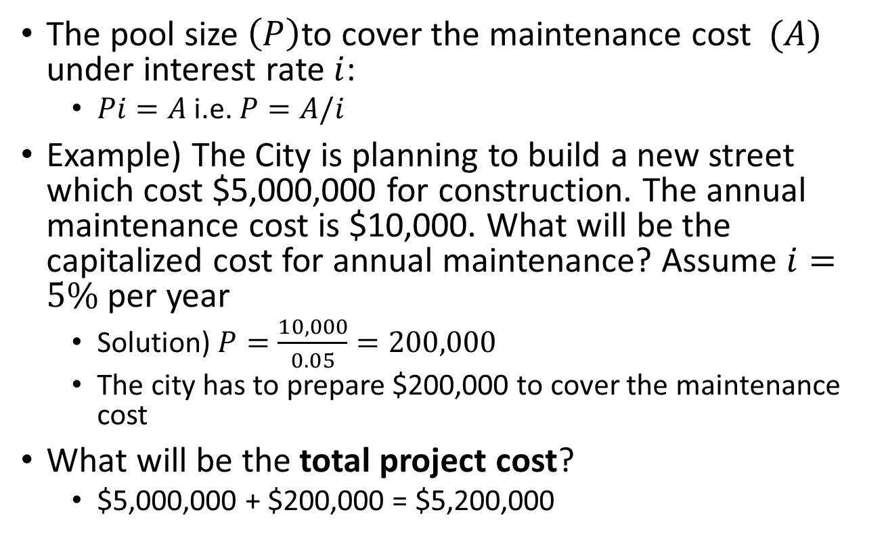
Capitalized cost: the pool size
The pool size $\left(P\right)$to cover the maintenance cost $(A)$ under interest rate $i$:
$Pi=A$ i.e. $P=A/i$
Example) The City is planning to build a new street which cost $5,000,000 for construction. The annual maintenance cost is $10,000. What will be the capitalized cost for annual maintenance? Assume $i=5\%$ per year
Solution) $P=\frac{10,000}{0.05}=200,000$
The city has to prepare $200,000 to cover the maintenance cost
What will be the total project cost?
$5,000,000 + $200,000 = $5,200,000

